Slide 1
Exploring MAF's Programs and Services

Slide 2
Meet the presenter:
Diana Adame
Campaign &
Outreach Manager

Slide 3
We are on a mission to help people become
visible, active, and successful
in their financial lives.

Slide 4
Today,
we'll review
1
MAF's Loan Programs
2
Resources
3
Q&A

Slide 5
Immigration Loans

Slide 6
Immigration Loan Program
Get a 0% interest loan to help you pay your USCIS application fee
Make low monthly payments over 10 months
Build your credit history

Slide 7
Which filing fees are covered?
Temporary Protected Status
$495
Citizenship
$725
Green Card
$1,225
Petition for Immigrant Relatives
$535
Advance Parole
$575
DACA
$495

Slide 8
Example: Citizenship Loan
$72.50
10
Months
$725
Remember it's 0% interest

Slide 9
How the program works
1
2
3
APPLY
GET THE CHECK
SUBMIT TO USCIS
Apply online for MAF’s immigration loan at bit.ly/immiloans
You’ll receive a check in the mail made out to the U.S. Department of Homeland Security
Mail your check and immigration application to the USCIS filing center

Slide 10
Start your application today at:
bit.ly/immiloans

Slide 11
Lending Circles
Notes:
Diana
26-38

Slide 12
Social lending
It’s a global practice
People come together
To lend & save money

Slide 13
Access a 0% interest social loan
Establish and build your credit
Lending Circles Program
Increase your financial knowledge
Know your money is safe
Meet new people and save together

Slide 14
How Lending Circles work
$100

Slide 15
How Lending Circles work
$800

Slide 16
How Lending Circles work
$800

Slide 17
How Lending Circles work
$800
1st
$800

Slide 18
How Lending Circles work
$800
1st
$800
2nd
$800

Slide 19
How Lending Circles work
$800
1st
$800
2nd
$800
3rd
$800
$800
4th
$800
5th
$800
6th
$800
7th
$800
8th

Slide 20
How Lending Circles work
$100
$50
$200
6-12 People
$600 - $1,200
6-12 People
$300 - $600
6-12 People
$1,200 - $2,400

Slide 21
18+ years old
Personal email address
Program requirements
Valid photo I.D.
SSN or ITIN
Checking account
Income (e.g wages, benefits, etc.)

Slide 22
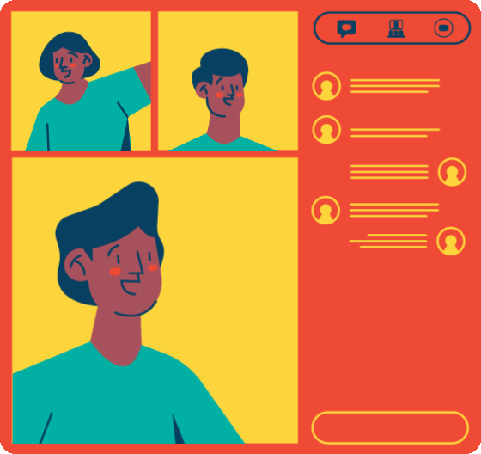
How do I join Lending Circles?
1
2
3
4
APPLY ONLINE
JOIN LENDING CIRCLE
PAY & BUILD CREDIT
GET YOUR
LOAN
Fill out the following form:
mafito.info/programs-eng
Attend a formation to meet people in your community and finalize circle details
Make all your payments on the 17th of each month to establish or build credit
Receive your loan on the 25th of your designated distribution month

Slide 23
For more information
Fill out the form mafito.info/programs-eng

Slide 24
MAF's Business Microloan

Slide 25
Get a 0% interest loan up to $2,500 to cover any business expenses
Business
Microloan
program
Make low monthly payments over
10-18 months
Build your credit history
Access free online financial education and business coaching

Slide 26
Eligibility requirements
Have a business that you’re looking to start, run or grow
Have a SSN or ITIN, a valid, government-issued ID, and a
checking account
Provide proof of income (personal or household)
Live in California

Slide 27
Give your business a boost!
GROW YOUR
BUSINESS
DEVELOP YOUR
BUSINESS IDEA
Promote your business
Pay for repairs or renovations
Build your plan
Buy licenses, permits, or equipment
LAUNCH YOUR
BUSINESS
Cover start-up costs
Order marketing materials

Slide 28
How to get started
1
2
3
GET BUSINESS COACHING
APPLY FOR A MICROLOAN
GET
MICROLOAN
Need business advice? Talk to MAF’s Business Coach first
Apply for MAF’s Business Microloan & complete all program requirements
Get your microloan to use the funds for any business expenses and build credit through monthly payments

Slide 29
For more information
Fill out the form mafito.info/programs-eng

Slide 30
Resources

Slide 31
Charlas Financieras
Financial topics, tools, and tips to support you in your financial journey!
Free, online, and offered in English and Spanish.
Explore and register for upcoming charlas at mafito.info/maf-next-charlas

Slide 32
Financial Coaching
1-on-1 coaching tailored to your financial needs
Make an appointment at
bit.ly/MAFfinancialcoaching
Via zoom or phone
1 hour sessions

Slide 33
Business Coaching
1-on-1 coaching tailored to your financial needs
Make an appointment
bit.ly/SFBizDev
Via zoom or phone
1 hour sessions

Slide 34
Download our FREE MyMAF app!
Learn more about financial topics.

Slide 35
Stay
connected
WEBSITE
MissionAssetFund.org
EMAIL
programs@missionassetfund.org
FACEBOOK
@MissionAssetFund.org
TWITTER
@MAFpajarito
INSTAGRAM
@MissionAssetFund

