Slide 1
Chinese Community Mental Health in San Mateo County
Immigration Forum Monthly Meeting
Jessie Ren & Alyson Suzuki, Co-Chairs
Chinese Health Initiative, San Mateo County BHRS Office of Diversity and Equity

Slide 2
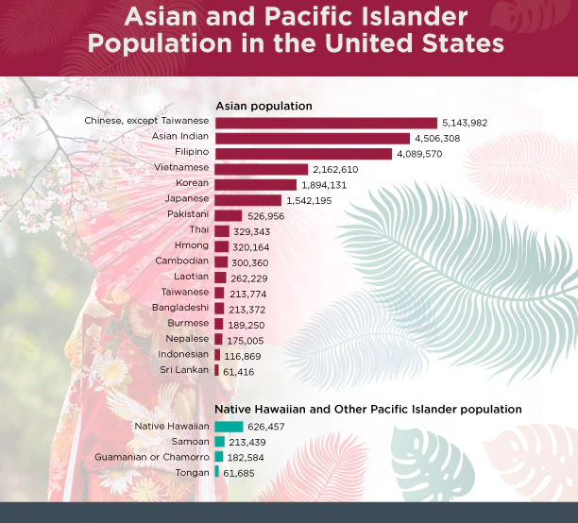
"AANHPI"
Stands for "Asian American Native Hawaiian Pacific Islander"
~7% of U.S. population
~60% of world population

Slide 3
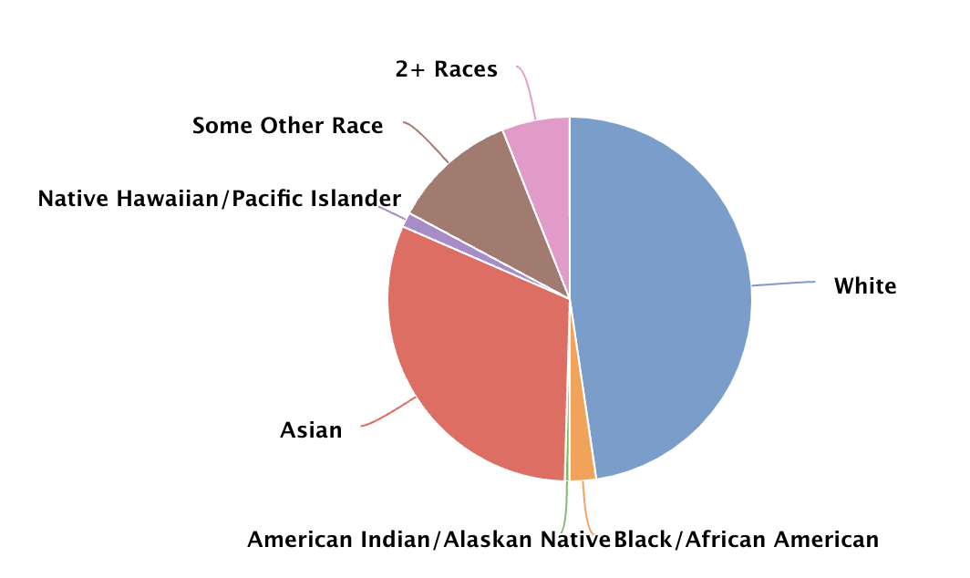
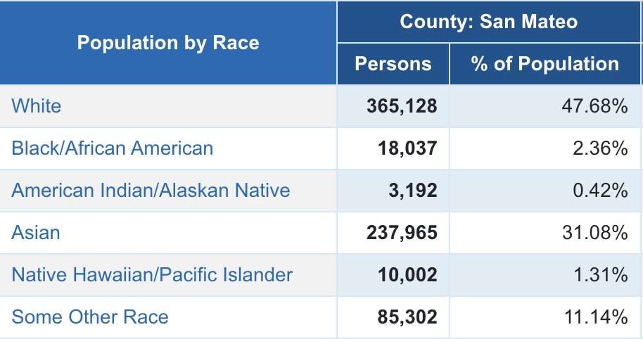
San Mateo County AANHPI community
>30% of population
Lowest penetration rates for specialty mental health services
Not out of a lack of need
Source: County of San Mateo
Notes:
True for adults, children and youth

Slide 4
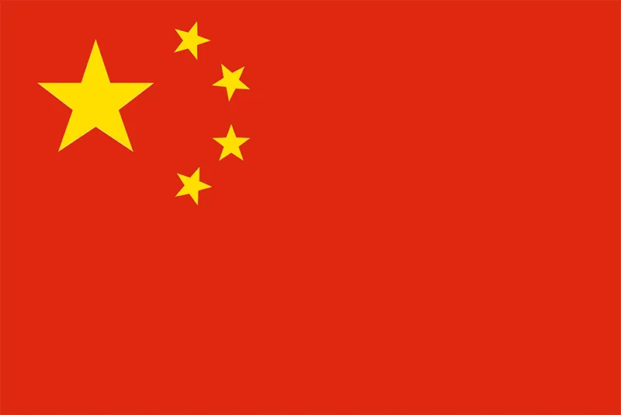
Chinese Diaspora
Diversity within "Chinese"
National identities
Language
1st, 2nd, 3rd etc. Generation
Notes:
Among Chinese-speaking households in San Mateo County, data showed that it was about 50-50 those who self identified as speaking English "very well" versus "not very well"

Slide 5
Statistics on Mental Health in AANHPI and Chinese Communities
According to 2021 CDC data, suicide is the leading cause of death among young Asian Americans aged 15-24
From 2019 to 2020, San Mateo County saw an increase in suicide deaths among Asian males born outside of the US (top countries include China, Hong Kong and Philippines)
In a 2013 study of psychiatric hospitalizations in Hawaii, AANHPIs tended to have greater severity of illness and longer admissions than other groups.
Less likely to seek "professional" mental health assistance and more likely to seek help through other means (e.g. family, friends, community figures)?
Effects of stigma towards mental illness?
Under-diagnosis of mental illness and lack of culturally sensitive / Chinese-speaking clinician?
Effects of anti-Asian hate incidents, which received increased attention since 2020
Sentell TL, Unick G, Ahn HJ, Braun K Miyamura J, Shumway M. (2013). Rates and illness severity for inpatient psychiatric hospitalizations among Asian Americans and Pacific Islanders. Psychiatric Services 64(11):1095-102

Slide 6
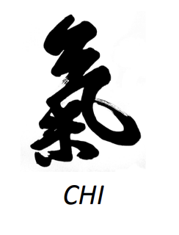
Chinese Health Initiative
Created in 2007 out of the San Mateo County Office of Diversity and Equity to promote cultural competence and address health inequities in San Mateo County. Comprised of community partners, consumers/clients, and family members.
Our goals:
Raise awareness of health issues and availability of services available throughout the County through community outreach, engagement and education.
Educate the Health System and our partners around cultural issues and potential barriers around working with the Chinese community.
Advocate for services that are culturally and linguistically accessible and welcoming to the Chinese community.
Work collaboratively with partners to facilitate access to services for the Chinese community.

Slide 7
Some Past Events that CHI has hosted
2014- Cultivate Wellness
2015- Mills High School Parent Workshop
2017 – Health Care Rights and Immigration Forum for the Chinese Community
2018- AANHPI Intergenerational Feast of Wellness
2020 - Mandarin for Mental Health Language Workshops
2021- Eddy Zheng on Hate and Violence Against AAPI communities
2023 –What I wish my parents knew

Slide 8
"Asians Be Well" outreach to the elderly
Reaching out to Elder Chinese adults during the pandemic – isolation and fears about anti-AAPI violence
Collaboration with Travonde, CHI and Aging & Adult Services, and Self Help for Elderly
Sessions in Cantonese on mental health/wellness, coping with recent events, nutrition, and preventive health

Slide 9
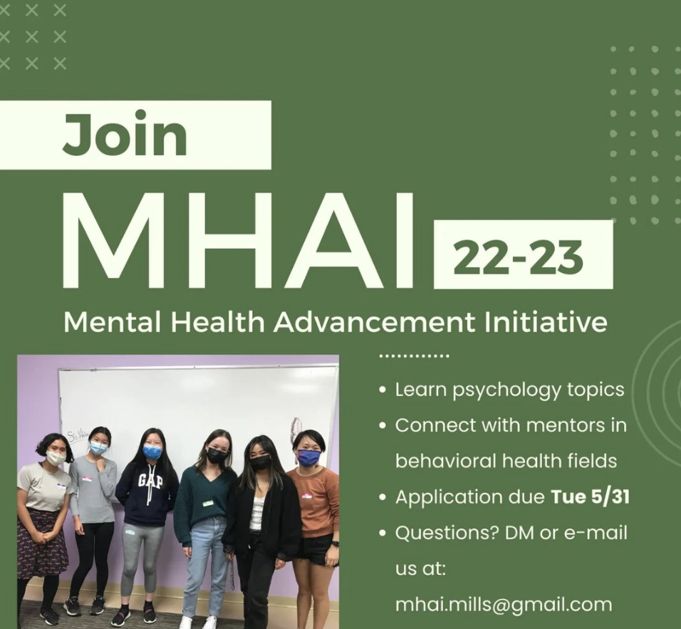
Mills High Youth Leadership Program
Mental Health Advancement Initiative (MHAI)
Collaborative effort between students, faculty, and community advocates
Goal is to increase mental health awareness and provide resources to those with mental health conditions

Slide 10
Be Sensitive Be Brave Workshops
Culturally adapted mental health and suicide prevention workshops for the Mandarin-speaking Chinese community
Partnership between BHRS ODE, Palo Alto University (Dr. Joyce Chu), and Star Vista

Slide 11
Resources
Chinese Health Initiative Monthly Meeting: 1st Fridays, 1:30-3:00 PM on Zoom. All are welcome!
CHI website: https://www.smchealth.org/chinese-health-initiative
Chinese Community Referral Line: 650-381-4078
Mental Health Association for Chinese Communities: https://www.mhacc-usa.org/
Self Help for the Elderly: https://www.selfhelpelderly.org/san-mateo
Please contact CHI@smcgov.org for more info on these resources!

