Slide 1
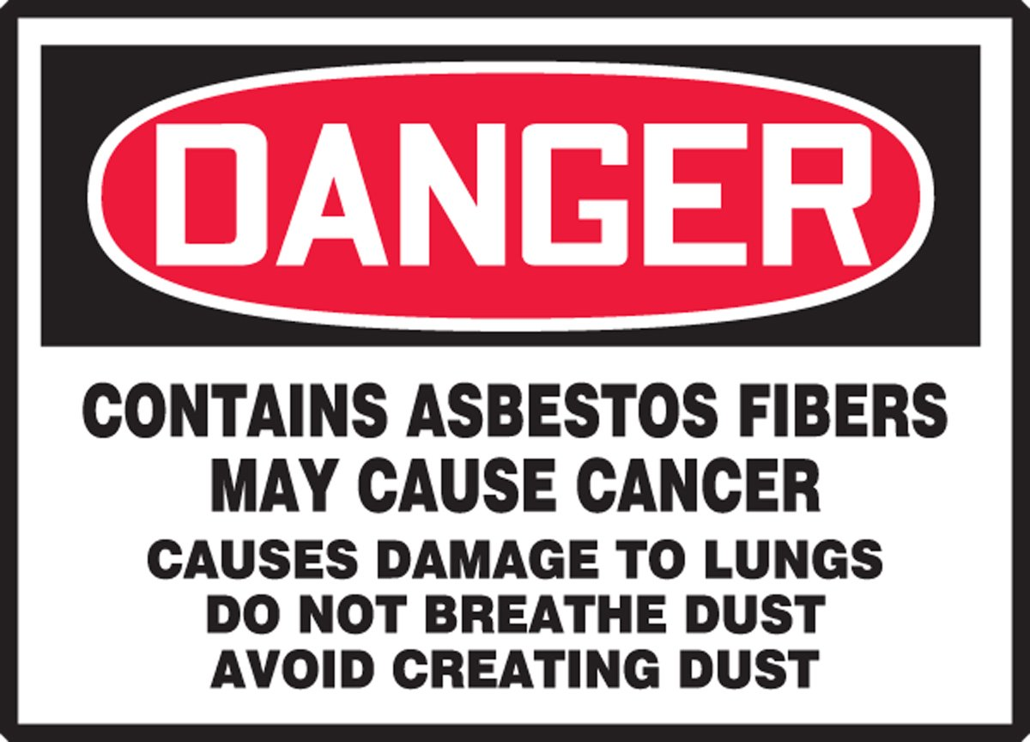
Serving veterans affected by asbestos-diseases and collaborating with VSOs to assist veterans in their communities
888-327-8271
Veterans Asbestos Claims Assistance
Veteran Outreach brought to you by Asbestos.com

Slide 2
How we help veterans
Support Literature
Medical diagnostic information
Mesothelioma Doctor Match Assistance
Connecting with financial help – grants, legal, VA, travel assistance
Understanding VA Claims Evidence Development
Nexus Statements
Exposure Summaries
Connecting with local VSOs

Slide 3
About the team
Aaron Munz – Veteran Director
Patient Advocate at Asbestos.com since 2015
VA Accredited Claims Agent
Army Veteran, Armor Officer
Danielle DiPietro - Veteran Outreach Specialist
Patient Advocate at Asbestos.com since 2013
VA Accredited Claims Agent
Karen Selby, RN, Support Group Leader
Dr. Snehal Smart, MD
Vanessa Blanco, MHA, OPN-CG - oncology patient navigator
Amy Pelegrin, Home Health Care/Hospice Navigator

Slide 4
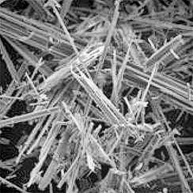
Asbestos Exposure
Fibrous Minerals - resistant to heat and corrosion
Safe in solid form - dangerous when they release fibers
Latency Period - The latent period for development of disease due to exposure to asbestos ranges from 10 to 45 or more years between first exposure and development of disease.
Used in construction materials, insulation, pipe lagging, brake pads, clutch faces, flex gaskets, fireproofing, fire resistant PPE, Navy non-skid paint

Slide 5
Elements of a successful VADC claim
Nothing is presumptive for non PACT Act asbestos claims – must prove medical connection and military exposure
PACT Act does not cover pre Persian Gulf War or 9/11 Asbestos Exposure – (Toxic Exposure Risk Activity - TERA)
Must have a valid diagnosis
VA requires a nexus statement from a medical specialist stating that asbestos is the cause of the diagnosis
Must be able to prove exposure to asbestos during military service - a majority of lifetime exposure
va.gov/disability/eligibility/hazardous-materials-exposure/asbestos/

Slide 6
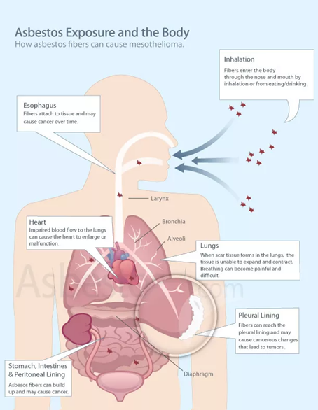
VA Asbestos Related Claims
Conditions the VA recognizes- M21-1, Part VIII, Subpart iii, Chapter 7, Section A
· fibrosis, the most commonly occurring of which is interstitial pulmonary
fibrosis, or asbestosis
· pleural effusions and fibrosis
· pleural plaques
· mesotheliomas of pleura and peritoneum
· cancers of the
- lung
- bronchus
- gastrointestinal tract
- larynx
- pharynx, and
- urogenital system, except the prostate.
· All persons with significant asbestosis develop cor pulmonale, heart disease secondary to disease of the lung or its blood vessels, and those who do not die from cancer often die from heart failure secondary to cor pulmonale.

Slide 7
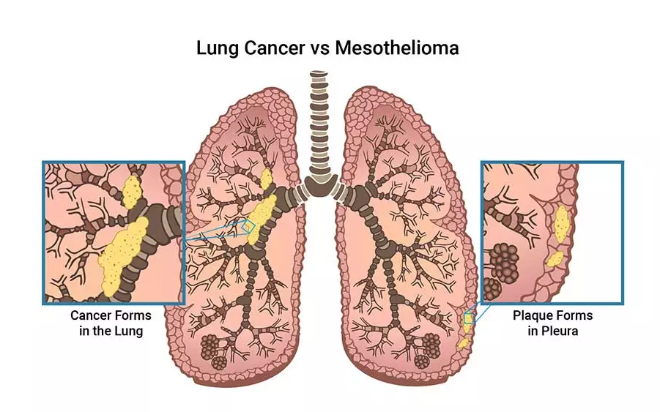
Mesothelioma Cancer
Is not lung cancer – affects the linings of organs
4 Types – Pleural (lungs) Peritoneal (abdomen)
Pericardial (heart), Testicular
Most commonly caused by asbestos exposure
Veterans make up 30% of 2,500 DX each year
Pathology states malignant mesothelial cells = mesothelioma
Aggressive – patients who are treated by specialty center have more options
https://www.asbestos.com/mesothelioma/

Slide 8
Diagnostic Testing
Asbestos lung disease testing must have two components
Chest imaging - CT scan with contrast is gold standard for dx
Pulmonary Function Test (PFT) - Spirometry
Pulmonary Lung Specialists are best trained to DX RLD/ILD
Can differentiate between COPD and Restrictive Lung Disease/ Interstitial LD
Asbestos related cancer requires tissue biopsy and pathology report
Nexus statements for cancers other than mesothelioma must be written by an oncologist
Underlying asbestos-lung disease helps make the connection

Slide 9
Nexus Statements
Must include the connection between the current diagnosis and asbestos
The opinion should be expressed as follows:
1. “is due to” (100% sure)
2. “more likely than not” (greater than 50%)
3. “at least as likely as not” (equal to or greater than 50%)
Must also include a medical rationale for making the conclusion
Evidence based - refer to scans, pathology report, other existing asbestos related illness, consistent with latency period of exposure during service

Slide 10
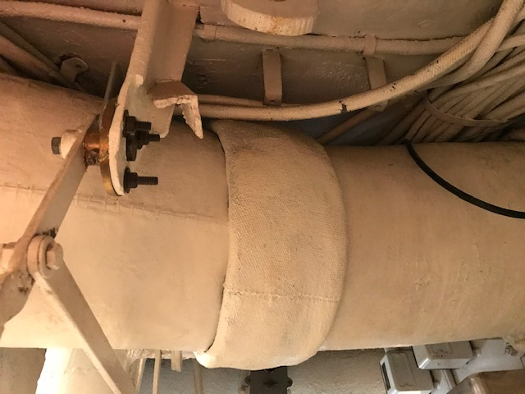
Asbestos Exposure Summaries
Do not assume that the VA knows how a veteran was exposed to asbestos based on MOS
Provide detailed summaries of the 5 W’s and How the veteran was exposed - duty locations, ships, specific equipment
Buddy Statements and Pictures if possible

Slide 11
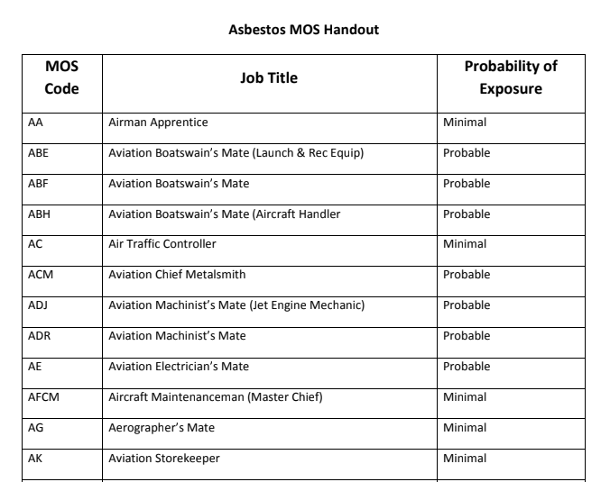
Department of Veterans Affairs M21-1, Part VIII, Subpart iii Chapter 7, Section C Veterans Benefits Administration July 29, 2021
M21-1, Part VIII, Subpart iii, Chapter 7, Section C - Evaluating Evidence of Asbestos Exposure

Slide 12
Asbestos Exposure Summaries
Questions to ask veterans to develop asbestos claim
Do you think you had more exposure during your service?
Where, when how were you exposed to asbestos?
If Navy or Coast Guard – Rating – is Highly Probable?
Shipyard or Drydock maintenance periods?
What type of equipment did you work with?
Vehicle and/or equipment maintenance/ PMCS and or services?
Brakes, insulation,construction,demolition,BDA in combat?
Did you work outside of your MOS or work details doing maintenance etc?
What type of work did you do before and after military service?
Did you receive any training or PPE for handling asbestos in service and/or civilian career?

Slide 13
Asbestos Exposure Summaries
Calculating asbestos exposure if there is civilian exposure
VA looks at number of years of asbestos exposed work
Not all exposure is equal – must illustrate that to the VA
1 year on a Navy ship is 365/24/7 Exposure = 8,760 hours of exposure
1 year in a factory (50 weeks/ 40 hr/wk) = 2,000 hours of exposure
OSHA Asbestos regulations – 1971, 1976, 1983, 1986 – each lowered the PEL – Permissible Exposure Limit
osha.gov/laws-regs asbestos
Many civilian employers implemented asbestos safety procedures to avoid exposure liability – most began in late 1970’s early 1980’s
Helps to demonstrated less civilian exposure after safety regulations

Slide 14
Exposure Summaries – Key Phrases
During my service in the Navy, I was never informed about the dangers of asbestos, and no breathing protection or any other protective gear or clothing was supplied.
My military records during my service in the Navy will not show any asbestos-related diseases due to the long latency period. This is consistent with M21-1, Part VIII, Subpart iii, Chapter 7, Section A - General Information on Claims Based on Exposure to Asbestos, “Many people with asbestos-related diseases have only recently come to medical attention because the latent period for development of disease due to exposure to asbestos ranges up to 45 or more years between first exposure and development of disease.”

Slide 15
VA Disability Ratings
38 CFR 4.97 Schedule of Ratings - Respiratory System
For an active cancer the rating is 100% disability - 38 CFR 4.97 6819
For all other non cancerous asbestos lung diseases the VA rates based on the results of a Pulmonary Function Test (PFT)
Different Criteria for Restrictive Lung Disease (Chronic pleural effusion or fibrosis/pleural plaques) CFR diagnostic codes 6840 through 6845
and Interstitial Lung Disease/Asbestosis - CFR diagnostic codes 6825 through 6833

Slide 16
How to contact our team
Aaron Munz: amunz@asbestos.com
Phone: 888-327-8271
References/ resources
asbestos.com/veterans-outreach/
M21-1, Part-VIII,-Subpart-iii,-Chapter-7,-Section-A---General-Information-on-Claims-Based-on-Exposure-to—Asbestos
M21-1, Part VIII, Subpart iii, Chapter 7, Section C - Evaluating Evidence of Asbestos Exposure
va.gov/disability/eligibility/hazardous-materials-exposure/asbestos/
va.gov/education/factsheets/asbestos-exposure

