Slide 1
Cyber Threat Trends for 2018
SSA Elvis Chan
FBI San Francisco

Slide 2
Legal Disclaimer
The views and opinions of the presenter are personal to the presenter and do not necessarily reflect the official policy or position of any agency of the U.S. Government.
This presentation should not be considered or construed as legal advice on any individual matter or circumstance.
The contents of this document are intended for general information purposes only and may not be quoted or referred to in any other presentation, publication or proceeding without the prior written consent of the FBI.

Slide 3
Cyber Threat Continuum
Notes:
[More detailed talking points to come, upon approval of the slides.]

Slide 4
The Top Criminal Cyber Threats for 2018
Identity Theft
Business Email Compromise (BEC)
Ransomware

Slide 5
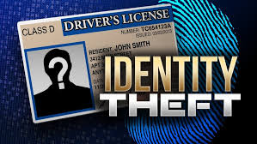
Identity Theft
“New account fraud” happens when an imposter opens lines of credit using personal information of another; this could include utilities, credit card accounts, mortgages, etc.
“Synthetic identity theft” happens when an imposter creates a new identity using some information from a victim but altering it in such a way that causes the credit agencies to create “subfiles” for the new accounts.

Slide 6
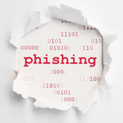
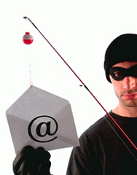
Business Email Compromise (BEC)
“Bank robbers don't rob banks anymore…they hide behind their computer screens and cover their digital tracks.”
In February 2015, Scoular Co, an Omaha-based company, lost $17.2 Million.

Slide 7
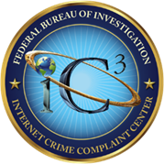
Initial Destinations of BEC/EAC Fraudulent Wire Transfers
BEC/EAC Reported to IC3
150 Victim Countries
115 Recipient Countries
Top 5 International Countries 2017-2018
Exposed Loss
Hong Kong
China
Turkey
United Kingdom
Bulgaria
Top 5 International Countries 2017-2018
Recipients
Hong Kong
China
United Kingdom
Mexico
Turkey

Slide 8
International Financial Fraud Kill Chain
United States Model
The Financial Fraud Kill Chain (FFKC) is a partnership between
law enforcement and financial entities whose purpose is to
recover fraudulent funds wired by victims of any crime type.
FFKC requests are coordinated through the Financial Crimes
Enforcement Network (FinCEN) Rapid Response Team and law
enforcement entities.

Slide 9
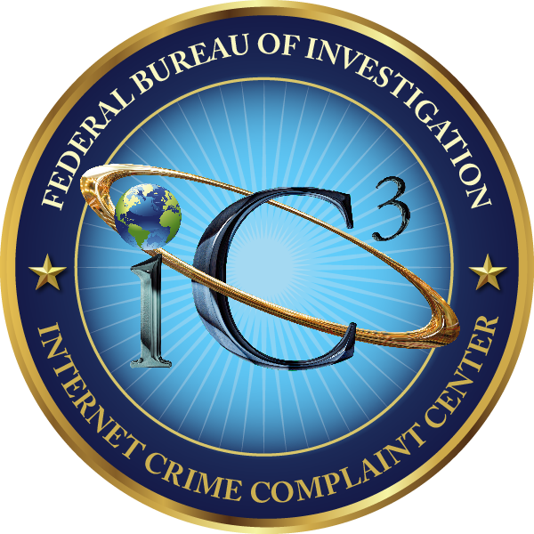
International Financial Fraud Kill Chain
United States Model
The following information is provided to the FinCEN Rapid Response Team requesting initiation of the FFKC:
Victim name
Victim location
Originating Bank Name
Originating Bank Account Number
Beneficiary Name
Beneficiary Bank Account Number
Beneficiary Bank Location
Intermediary Bank Name
SWIFT Number
Date of Transfer
Amount of Transfer
Summary of Incident
Notes:
The rapid response team work with the FIU’s in each country to recover funds.
The recovery process varies from country to country

Slide 10
Domestic Financial Fraud Kill Chain
The IC3 Recovery Asset Team (RAT) was established in February 2018 to assist the field and streamline communications to financial institutions in an effort to recover funds for victims.
Complaints submitted to the IC3 will be reviewed for RAT action if they meet specific criteria.
Notes:
RAT will review all crime types not limited to BEC
RAT will contact the recipient financial institutions and request funds be frozen
Follow up is made with the field via formal electronic communication notifying them of the requested action
IC3 does not contact victims, victims who appear to have wired funds to a fraudulent account are instructed to follow up with the sending institution requesting a hold harmless or letter of indemnity
Currently RAT is reporting an almost 80% recovery rate for the time period February to June 2018

Slide 11
Domestic Financial Fraud Kill Chain
What the RAT Does:
RAT will review all crime types not limited to BEC
RAT will contact the recipient financial institutions and request funds be frozen
RAT will contact the field via formal electronic communication notifying them of the requested action
Notes:
RAT may also act upon transactions <$50k

Slide 12
Domestic Financial Fraud Kill Chain
What the RAT Does Not Do:
RAT does not contact victims; victims who appear to have wired funds to a fraudulent account are instructed to follow up with the sending institution requesting a hold harmless or letter of indemnity
RAT does not issue seizure warrants
Notes:
LA FO is working with USSS contacts to assist in the recovery process where financial institutions will not provide HH or LOI on behalf of their victims

Slide 13
How Are They Doing This?

Slide 14
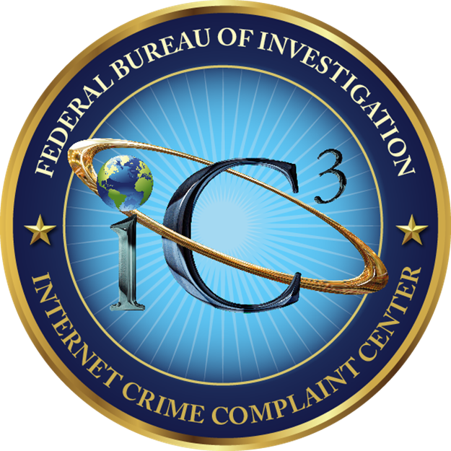
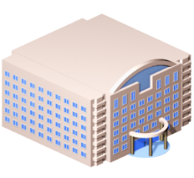
Financial Fraud Kill Chain
Victims encouraged to notify the following as soon as possible:
Financial Institution
2. US Federal Law Enforcement
3. File complaint with ic3.gov
IC3 complaints are vetted 24/7 to identify FFKC qualified victims
Investigative analysis
1
2
3

Slide 15
Social Engineering
Only amateurs attack machines; professionals target people

Slide 16
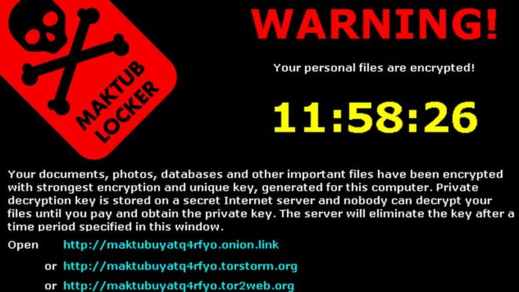
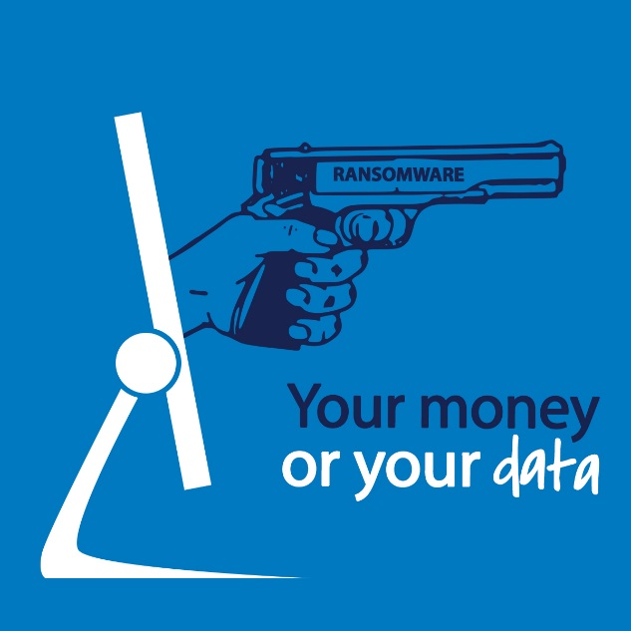
Ransomware
Ransomware has become a significant threat to U.S. businesses and individuals.
Perpetrators use ransomware to encrypt a user’s important files and documents, making them unreadable, until a ransom is paid.
Most of the newer ransomware variants collect payment solely in bitcoin.
Estimated $5 billion in damages globally for 2017 vs. $325 million in 2015.

Slide 17
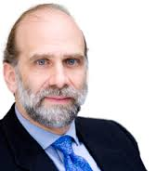
Why Does Social Engineering Work?
“The user’s going to pick dancing pigs over security every time” Bruce Schneier

Slide 18
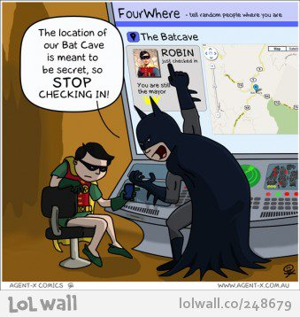
Social Engineering and Social Media
Non-technical kind of intrusion that relies heavily on human interaction and often involves tricking other people to break normal security procedures
ALMOST ALL businesses and executives have web presence
Results of Social Engineering
15% of Americans use social media to report when they have left the home*
*http://homesecurityblog.protectamerica.com/category/home-security-information/page/3/
Notes:
http://searchsecurity.techtarget.com/definition/social-engineering
http://www.indiatalkies.com/images/social-networking-sites-8192s.jpg
http://homesecurityblog.protectamerica.com/category/home-security-information/page/3/
http://activ8social.com/wp-content/uploads/2011/02/FacebookCheckInCardWeb.jpg

Slide 19
Guidance - Prevention
Our guidance for private industry:
Establish Security Policies…then prioritize
Support Established Security Policies
Monitor and Analyze Network Traffic
Assess Vulnerabilities
Configure Systems for Security (may mean $$)
Support/Provide Training for Employees

Slide 20
Guidance – Incident Response
Our guidance for private industry after an incident:
Follow your emergency plan and start protecting your data.
Call the local FBI field office.
Preserve original media as evidence (if not, ask if they can make a forensic image).
Request your IT specialists conduct analysis from a copy instead of the original (if possible).
Gather all pertinent log files (DNS, Firewall, Proxy, System Event Logs).
Contact ISP for additional logs and possibly provide filtering.
Conduct a damage assessment (including damage valuation).

Slide 21
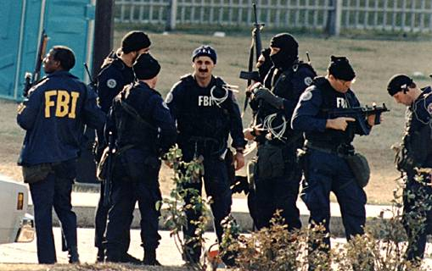
What the FBI does not do
Take over their systems.
Repair their systems.
Share their proprietary information with competitors.
Provide their investigation-related information to the media or your shareholders.

Slide 22
What can the FBI do for you?
Investigate
National and global reach
Combined technical skills and investigative experience
Long-term commitment of resources
Forensics
Silicon Valley Regional Computer Forensics Laboratory (SVRCFL)
Keeps options open for your company
Analyze Patterns and Links
Bring national security concerns to the U.S. Intelligence Community

Slide 23
Questions?
Online Resources
ic3.gov - Internet Crime Complaint Center
fbi.gov/investigate/cyber#How-to Protect Your Computer
Staysafeonline.org – National Cyber Security Alliance
dhs.gov/topic/cybersecurity – DHS
Identitytheft.gov - FTC
Abagnale.com – Frank Abagnale/Identity Theft

