Slide 1
GOOGLE Reverse Location History

Slide 2
What is Going to be Covered
What is Google Reverse Location History
Search warrant process for Google Reverse Location History
How to apply it to a real case and what to do for each step in the process

Slide 3
Case Study to Provide Context to a Google Reverse Location History (RLH) SW
FACTS OF THE CASE
On the morning of February 22, 2018, an armed home invasion occurred at 2059 S Delaware St in the City of San Mateo. The victim reported three armed black males wearing masks entered her residence demanding to know where the safe and money were located. The suspects stole the safe and fled the scene.
The suspects were able to avoid being captured on the victim’s home video surveillance system, the power to the residence was shut off prior to entry and the victim’s husband received a 10k cash deposit for his construction job the night prior to the crime.
All the factors above led investigators to believe the victims were targeted. From the outset there were no possible suspect leads provided by the victims. The victims denied being involved in any illegal activity and there was no evidence of such activity.
There were no investigative leads.

Slide 4
Overview of Scene

Slide 5
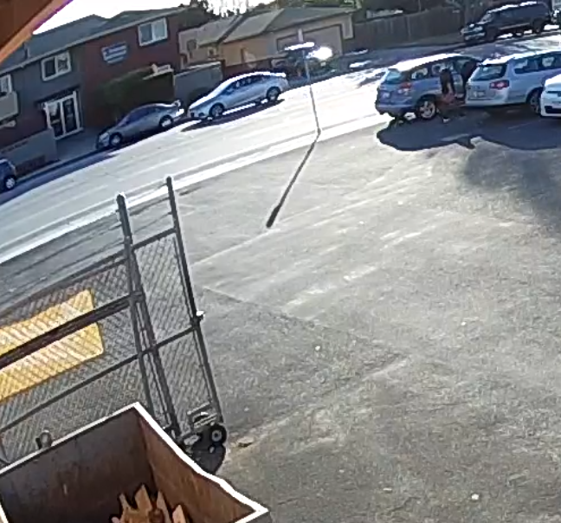
At 0820 hours the suspect vehicle drove northbound passed the victims’ residence

Slide 6
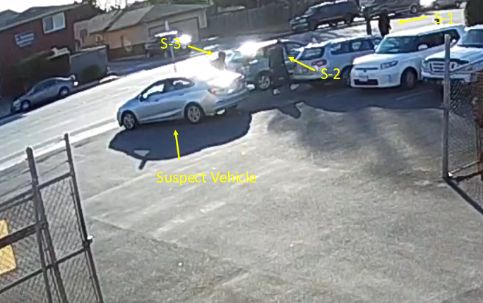
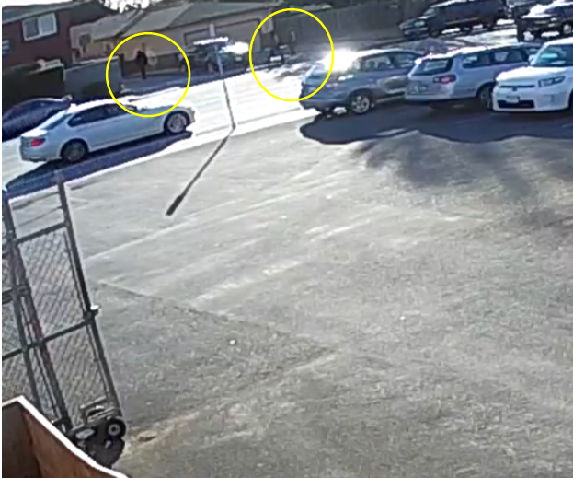
At 0823 hours the suspects are dropped off in a parking lot across the street from the victim’s residence.
At 0826 hours the suspects walked down a driveway of an apartment complex that parallels the victim’s residence.

Slide 7
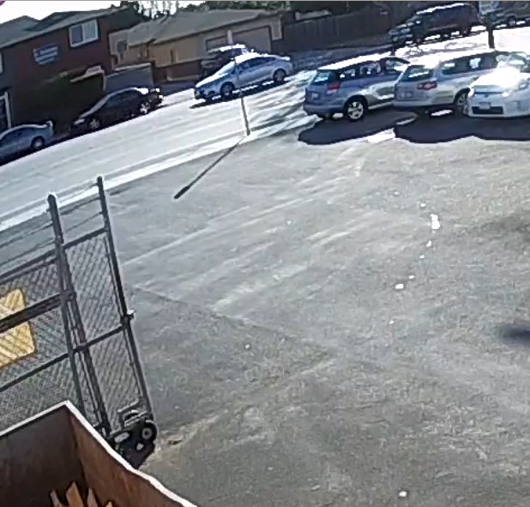
At 0856 hours the suspect vehicle fled the scene

Slide 8
What did I know?
Four suspects
In and around 2059 S Delaware St for 36 minutes (0820 hours to 0856 hours)
Gray Chevy Cruze was the suspect vehicle
Traditional Investigative techniques had been exhausted
My knowledge regarding Google’s collection of location history for Android devices
- Traditionally Google can provide location history for an Android device with a known Gmail account and/or IMEI number.

Slide 9
What’s Next?
Google Reverse Location History
Google collects location history information for Android devices with location services enabled and a Gmail address.
Google location history information is more commonly used when there is a known suspect.
Simply stated Google searches a defined area and timeframe for location history data within those parameters. The search can include one location or multiple locations.
Traditional Investigation:
Dmanion @gmail.com Date/Time Location History
Reverse Location History:
??????????????? Date/Time Geographical Location

Slide 10
Search Warrant Process
APPENDIX “A’
Direct to Google
Identify the date, time and geographical location
Define the geographical location with latitude and longitude coordinates
Option #1 – radius of “X” meters around a latitude/longitude coordinate
Option #2 - polygon defined by at least three lat/long coordinates connected by straight lines
Option #2 is Google’s preferred method

Slide 12
Search Warrant Process
APPENDIX “B”
Appendix “B” directs Google to provide the data in a three step process

Slide 13
APPENDIX “B” Step #1
Google will provide the location history data within the Target Location for the designated Time Period
- Google provides GPS coordinates, date and time stamps, radius of accuracy and data source (GPS, WiFi)
- Google will provide this information in an anayomized format.
- Google does this to protect the privacy of the account users that are ultimately unrelated to the investigation.
- Each respective device that records location data is given a Unique Identifier (i.e.1- 95) or Device ID (i.e. -492648)
If the longitude / latitude falls outside the designated geographical location then it will not appear in the results. If the longitude / latitude point falls just outside the location, but it would fall inside the location if the radius accuracy is taken into account, that long / lat point will not appear in the results.

Slide 14
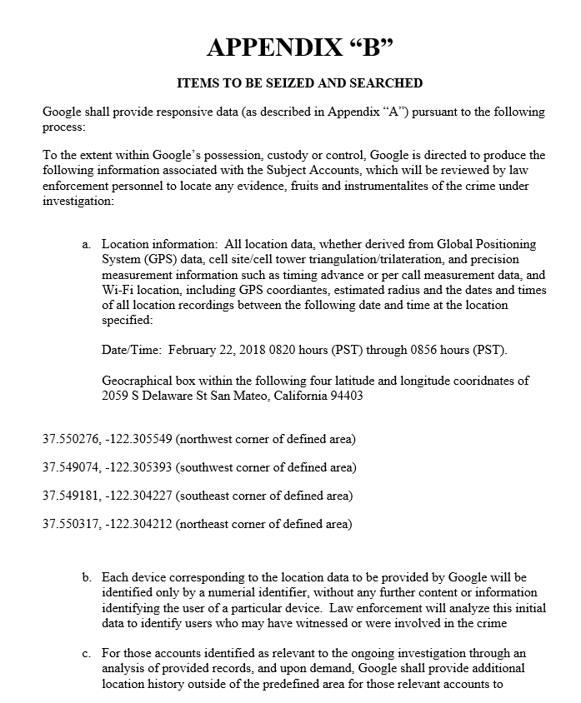
Step 1
Step 2

Slide 15
APPENDIX “B” Step #2 (Contextual Data)
Once the investigator has reviewed the data from step #1, the investigator will identify the Unique Identifier (UI) accounts that are relevant to the investigation.
- This can be accomplished by excluding UI’s location history data points that are inconsistent with the suspect(s) path of travel and inconsistent with the location compared to the time and other factors that are known to the investigation.
Once the investigator has identified the UI accounts relevant to the investigation, the investigator will request/receive Contextual Data for the relevant UI accounts from Google.
- Contextual Data is additional location history points that fall outside of the Target Location for the specified time period.
- The purpose of Contextual Data is to further narrow down the UI accounts relevant to the investigation.
The data for Step #2 is requested through an email to Google. However, I have heard of some judges requesting a new search warrant for each step in the process.

Slide 16
Step 1
Step 2

Slide 17
APPENDIX “B” Step #3
After the investigator has received the Contextual Data from Google, the investigator will further analyze the data to include or exclude UI devices as it relates to their relevance to the investigation.
If the investigator identifies a UI device(s) that are relevant to the investigation, Google will provide the subscriber information for the respective UI device(s).
The data for Step #3 is requested through an email to Google.

Slide 18
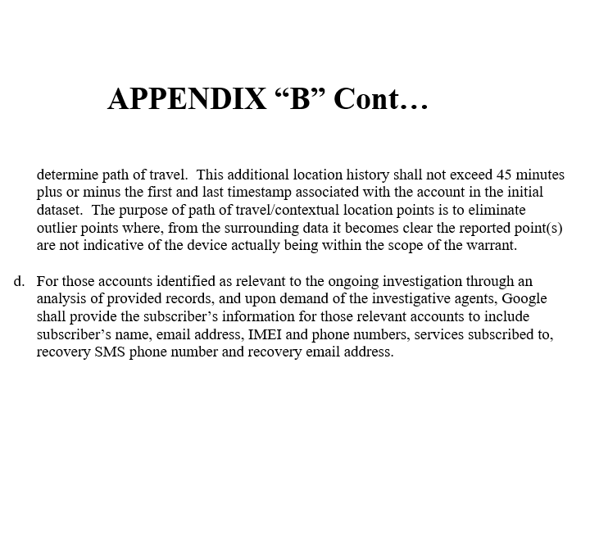
Step 3

Slide 19
STEP #1 Data Return 97 Unique Device Ids with 253 location history points

Slide 20
Step #1 Data Return
Reorder the data from Step #1 into order by UI # and made it mapping software friendly
Uploaded each UI into mapping software so I could analyze each UI individually

Slide 21
Location History for UI #40

Slide 22
Step #1 Data Return
Once I analyzed the data from the first step, I identified the UI device(s) that appeared relevant to the investigation.
I requested Google provide Contextual Data for the UI device(s) that appear relevant.
For this case I requested Contextual Data for UI #40 and 5 other UIs
The request for Contextual Data was done via email and did not require an additional search warrant.

Slide 23
Step #2 Data Return

Slide 24
Step #2 Data Return
Reordered the Contextual Data provided and make it mapping software friendly
Uploaded the Contextual Data for each UI into mapping software so they could be analyzed separately

Slide 25
Example illustrating the usefulness of Contextual Data to exclude a UI
Step #1 Data Return
Contextual Data for same UI

Slide 26
Example illustrating the usefulness of Contextual Data to include a UI
Step #1 Data Return for UI #40
Contextual Data for UI #40

Slide 27
Step # 3 Subscriber Information
Once I identified UI #40 as relevant to the investigation, I requested the subscriber information for UI #40.
The request was made via email to Google and did not require an additional search warrant

Slide 28
Subscriber Information

Slide 29
Results
Once I got the subscriber information from Google for UI #40, it give me the opportunity to use more traditional investigative avenues to investigate UI #40 further.
The user of UI #40 was identified as one of the suspects that entered the victim’s residence.
Additional search warrants ultimately revealed the user of the device for UI #40 went to the victims’ nephew house after the crime, during the commission of the crime the user of the device for UI #40 had an 11 minute phone call with the victims’ nephew and the victims’ nephew cell phone records showed the cell phone was in the area of the crime at the time.
The suspect who was IDed through the Google RLH SW and the victims’ nephew were arrested two weeks ago and the investigation is on-going to ID S-3 and S-4.

Slide 30
Google RLH search warrant for multiple locations
Same process as a RLH search warrant for one location.
I have not received the results yet. However, I’m told that if the same device appears in multiple locations, that device will by identified by the same UI in each location.

Slide 31
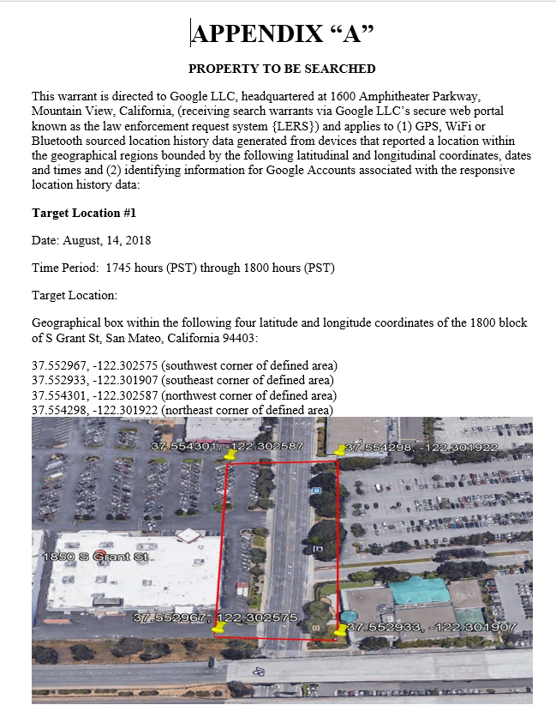

Slide 32
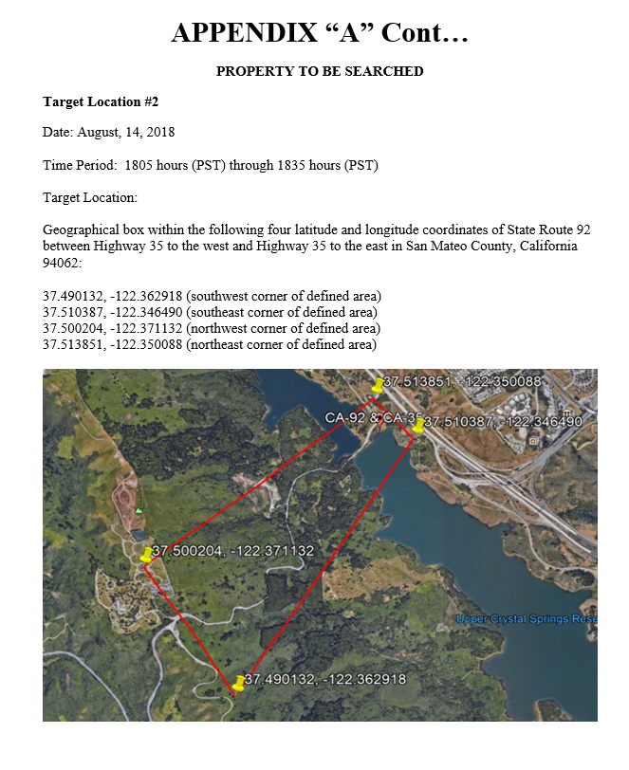

Slide 33
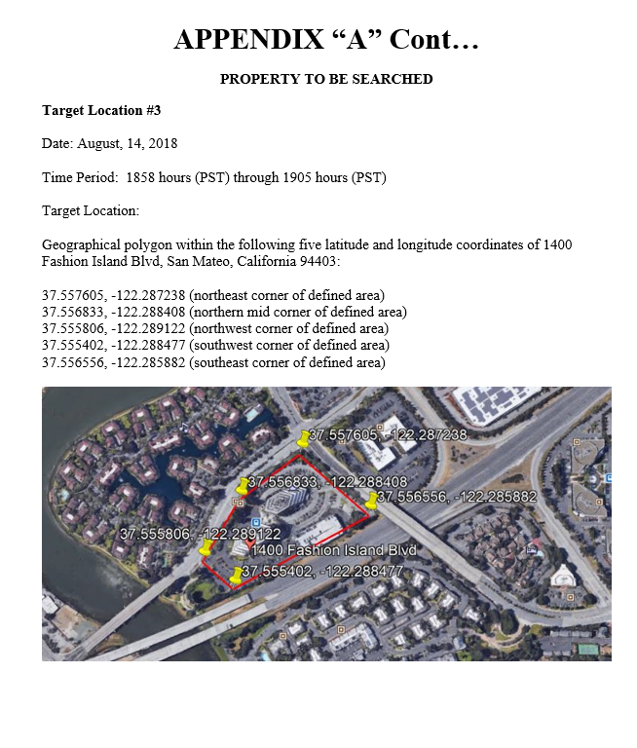

Slide 34
Potential pitfalls/disadvantages
Depending on the facts of your case, I would suggest limiting the size of the geographical area you select.
- A large populous geographical area will overburden you with data, which has the potential to muddy the waters.
If you want more useful information in Step #1, I suggest increasing the time period. This will allow you to evaluate data points based on the timeframe and the suspects known path of travel.
I would avoid using a reverse location history search if you do not have a defined time period.
As in any investigation, the more known facts such as the amount of suspects, the suspects path of travel and a time frame for when the suspects were in and around the crime scene is obviously beneficial.
If your suspect(s) aren’t using an Android device or using an Android device without the location services enabled, a reverse location history search will be useless.

Slide 35
Advantages
If you have multiple suspects and a known time period the suspects were in and around the crime scene, you should consider using a reverse location history search.
Although a reverse location history search can be thought of as a cell tower dump, it is not that at all.
Google provides lat/long coordinates which are much more precise than a phone pinging off of a cell tower. This allows you to narrow in on who your suspects are.
Develop investigative leads with a fairly simple process.
Google provided me with all three steps in the matter of 7 days.

Slide 36
Det. Dave Manion San Mateo PD 650-504-7568 dmanion@cityofsanmateo.org

