Slide 1
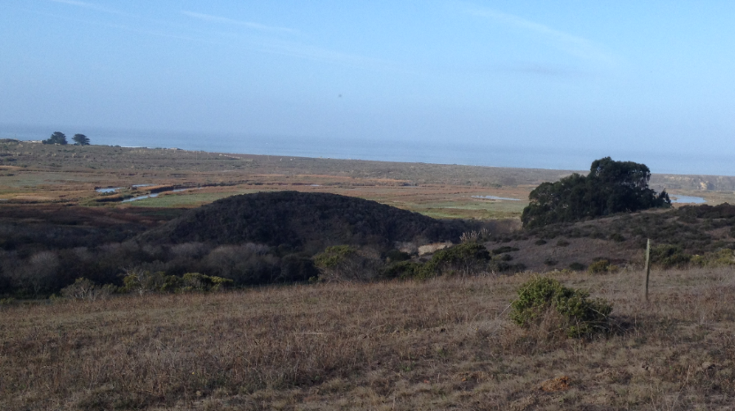
California Institute for Water Resources
California: Agriculture, Water, Drought
Doug Parker
Director, California Institute for Water Resources
Strategic Initiative Leader, UC ANR Water Initiative
doug.parker@ucop.edu
ciwr.ucanr.edu | @ucanrwater

Slide 2
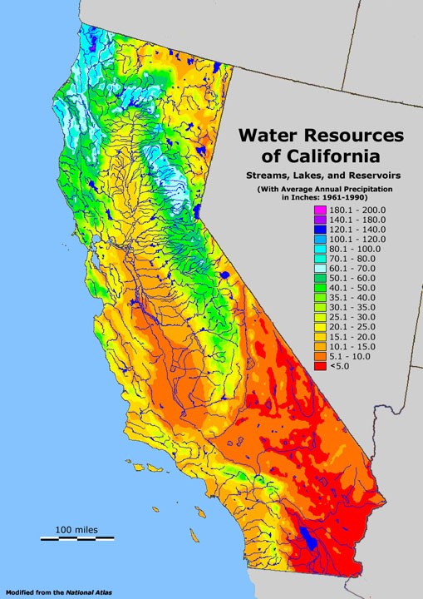

Slide 3
California’s Dedicated Water Use

Slide 4
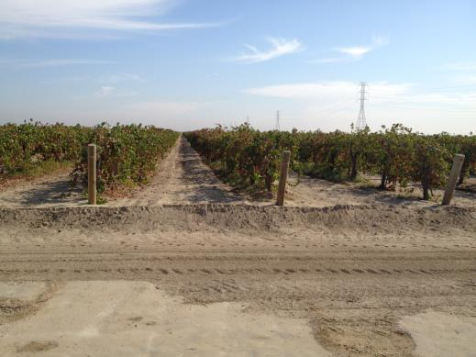
California Agriculture
$45 Billion Industry
#1 US Producer of 78 Commodities
Only US Producer of 14 Commodities
(99% or Greater)
Almonds | Kiwifruit | Pomegranates
Artichokes | Olives | Rice, Sweet
Dates | Peaches, Clingstone | Seed, Ladino Clover
Figs | Pistachios | Walnuts
Grapes, Raisin | Plums, Dried
Source: USDA, NASS, “California Agricultural Statistics, 2011 Crop Year”.

Slide 5
California Water Usage
200 Million Acre Feet (MAF) Precipitation
16 MAF Groundwater Withdrawals
71 MAF Runoff
56 MAF Agricultural Use
15 MAF Urban Use
Remainder is mostly Forest and Rangeland

Slide 6
CA Water Facts
43 MAF Surface Storage
150+ MAF Groundwater Storage
15 MAF Snowpack
Decreasing to 10-11 MAF with Climate Change

Slide 7
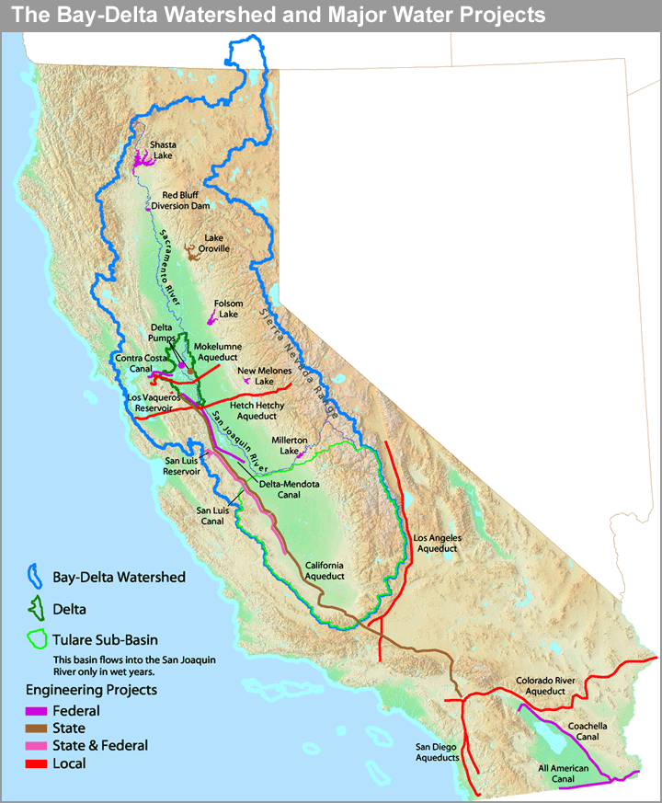

Slide 8
Sacramento-San Joaquin Delta

Slide 9
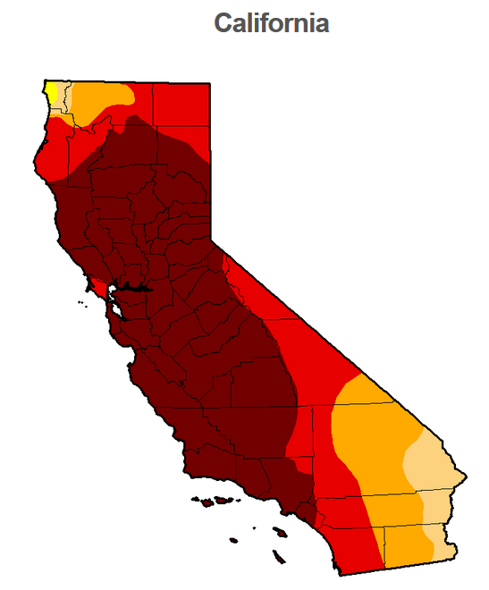
November 25, 2014
Source: http://droughtmonitor.unl.edu/Home/StateDroughtMonitor.aspx?CA

Slide 10
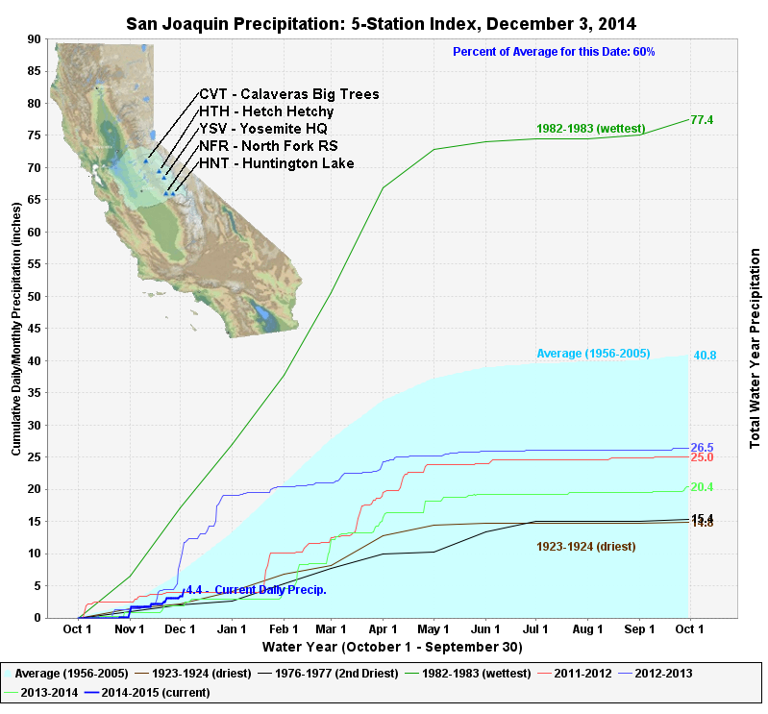
Source: http://www.water.ca.gov/waterconditions/droughtinfo.cfm

Slide 11
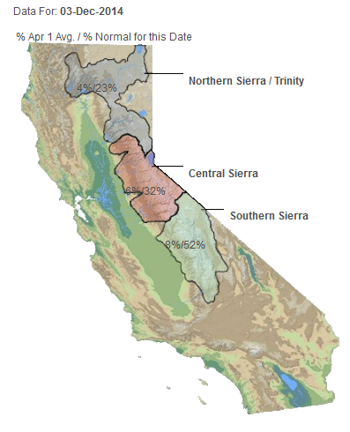
Source: http://www.water.ca.gov/waterconditions/droughtinfo.cfm

Slide 12
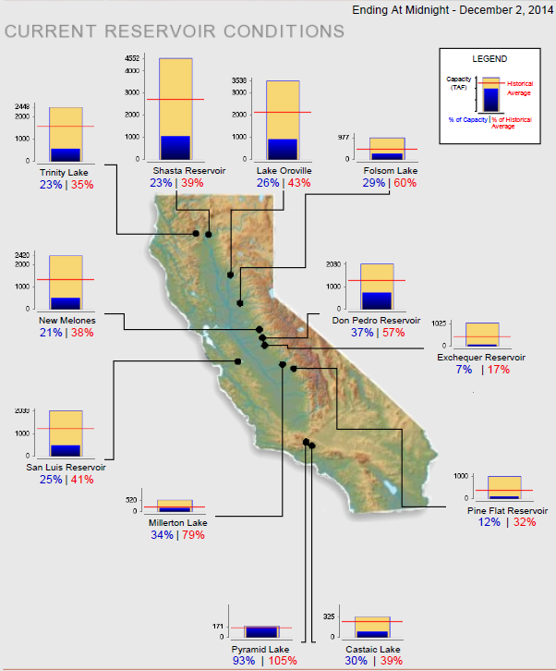
Source: http://www.water.ca.gov/waterconditions/droughtinfo.cfm

Slide 13
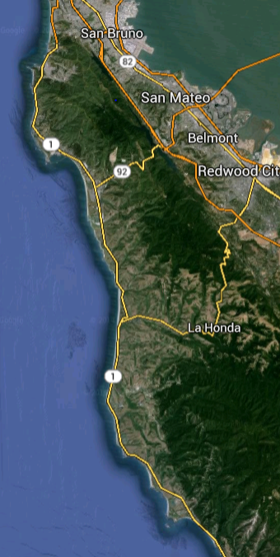
Water Systems in Coastal San Mateo County
Predominantly Residential and Commercial Supply
Montara Water and Sanitary District
Coastside County Water District
San Francisco Public Utility Commission

Slide 14
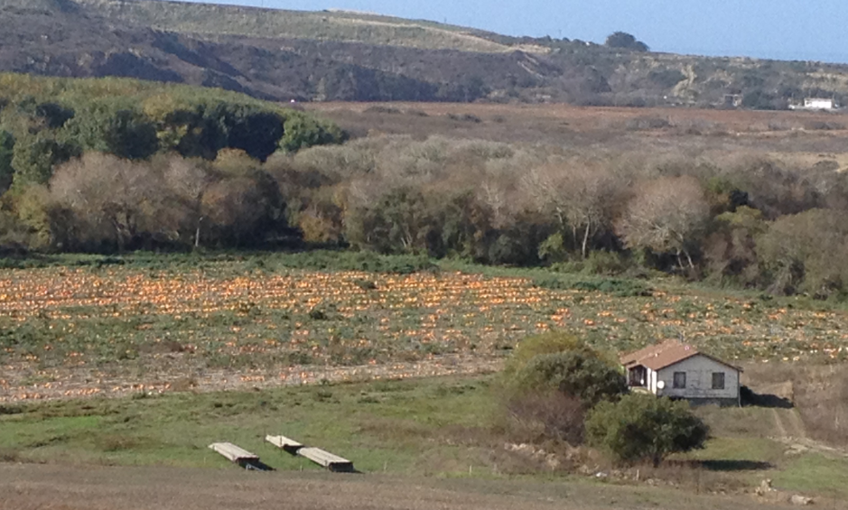
Water Supply in Coastal San Mateo County
Riparian Rights

Slide 15
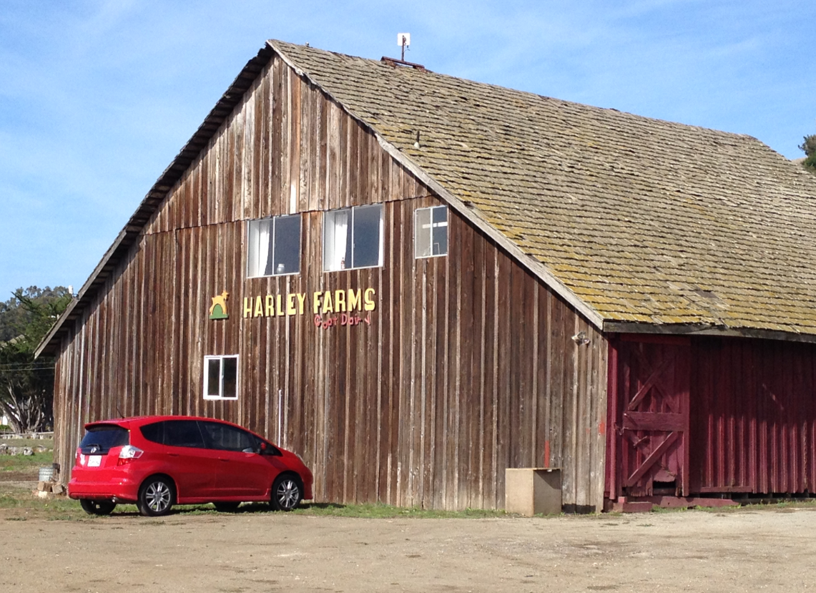
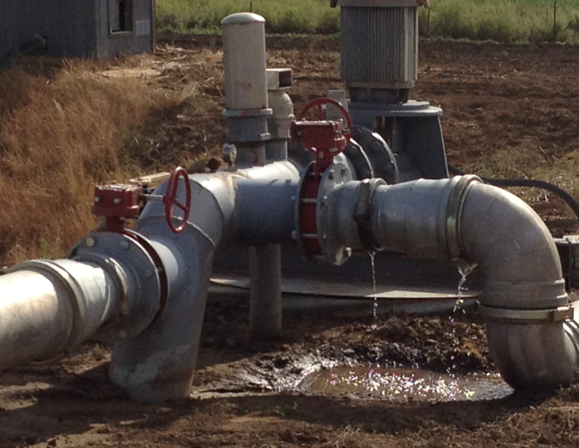
Water Supply in Coastal San Mateo County
Groundwater Wells

Slide 16
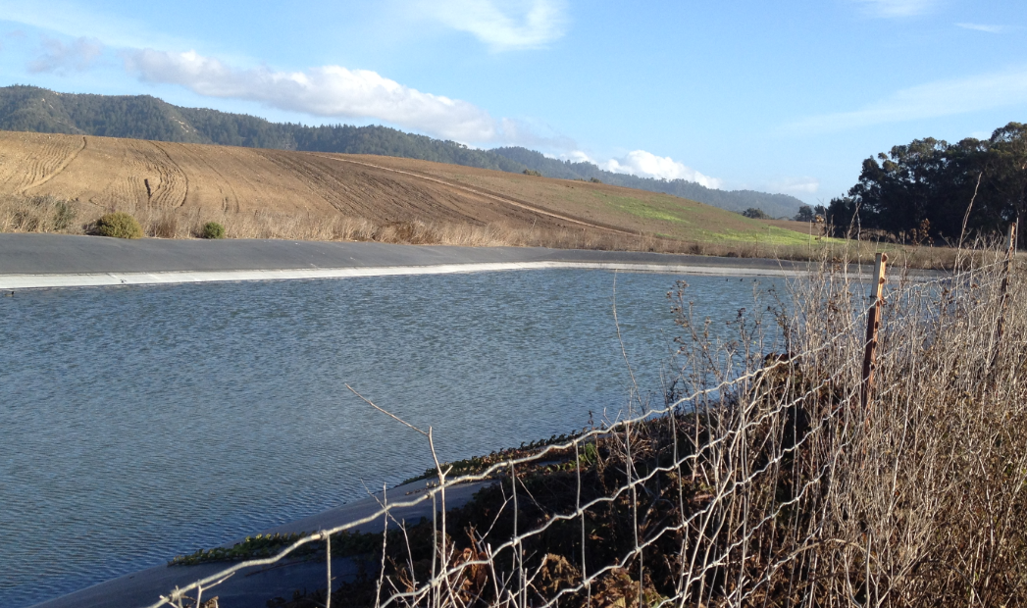
Water Supply in Coastal San Mateo County
Local Ponds and Reservoirs

Slide 17
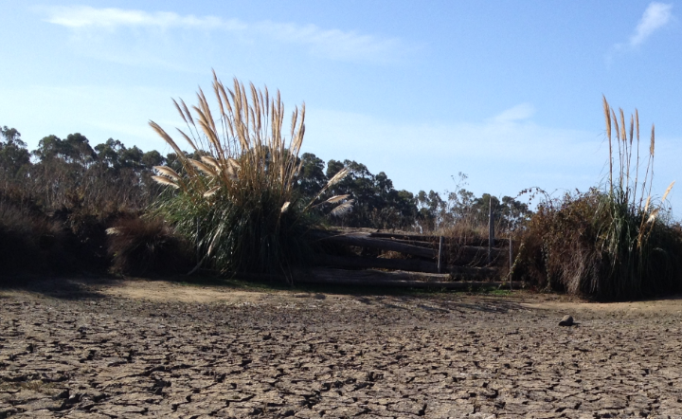
Drought Impacts in Coastal San Mateo County
Stream Flow
Groundwater Levels
Surface Systems

Slide 18
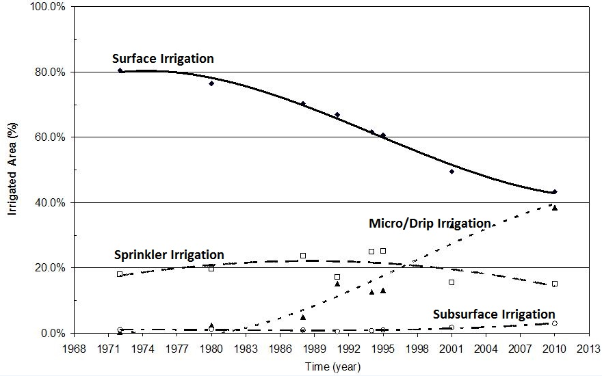
UC Drought Response
Tindula et al. (2013). Survey of Irrigation methods in California in 2010

Slide 19
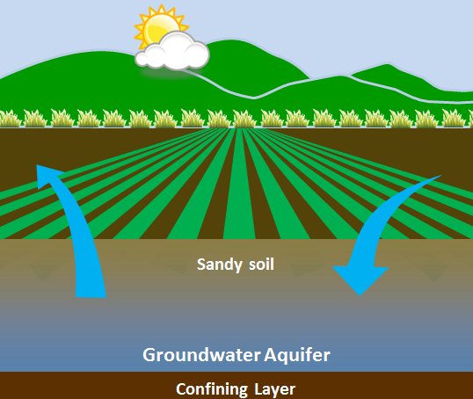
UC Drought Response
Managed Aquifer Recharge
Use Agricultural Lands to Recharge Groundwater in Wet Events
Bank Water for Drought Years
Potential for Use on Many Crops
Concerns for Groundwater Quality
Dahlke, et. al., 2014

Slide 20
Current Drought Resources
Web: ucanr.edu/drought for up-to-date resources
Twitter: @ucanrwater for daily updates

Slide 21
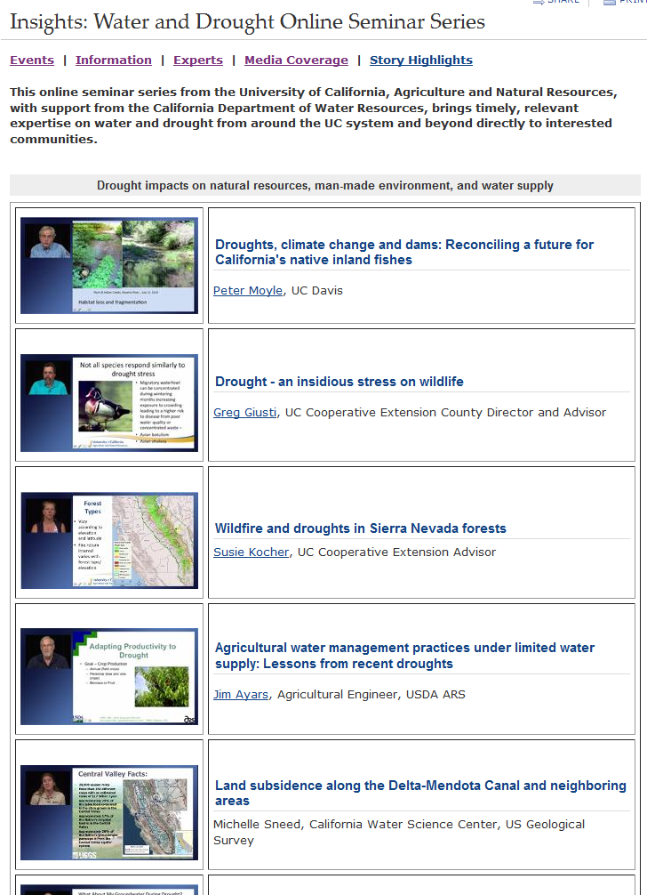
UC Drought Education and Events
Insights: Water and Drought Online Seminar Series
Drought Impact on Natural Resources and Environment
Drought Preparedness
Water Management for Urban Landscapes
Crop Management
Annual Crops
Permanent Crops

Slide 22
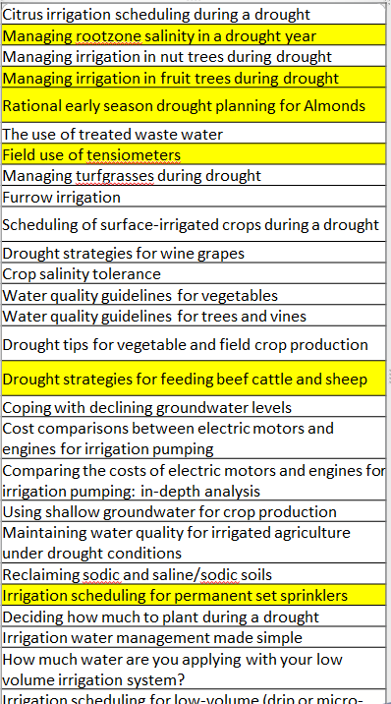
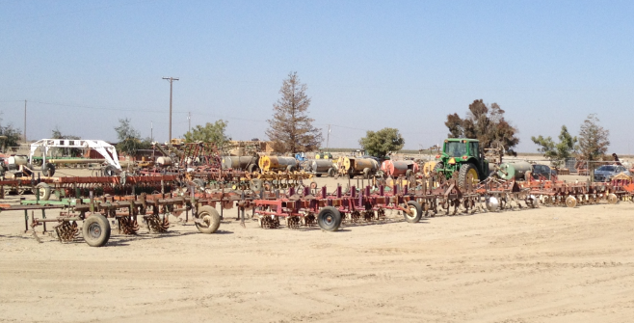
Upcoming Resources
Creation of Drought Tips Fact Sheets
Sponsored by DWR
Up to 50 Fact Sheets
More Video
Tip Website

Slide 23
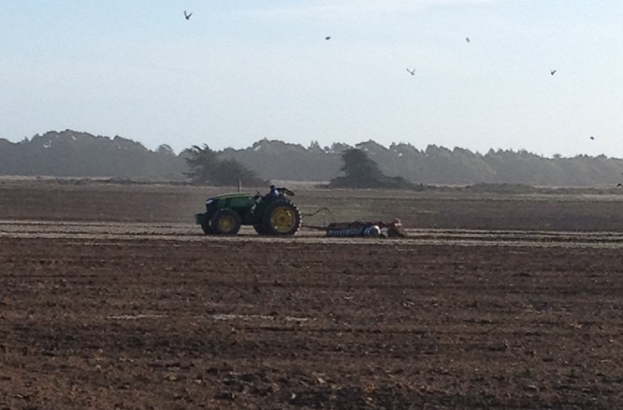
Thank You

