Slide 1
RCD & NRCS Water Solutions for Farmers and Ranchers
Presented to
San Mateo County Agricultural Workshop
December 5, 2014

Slide 2
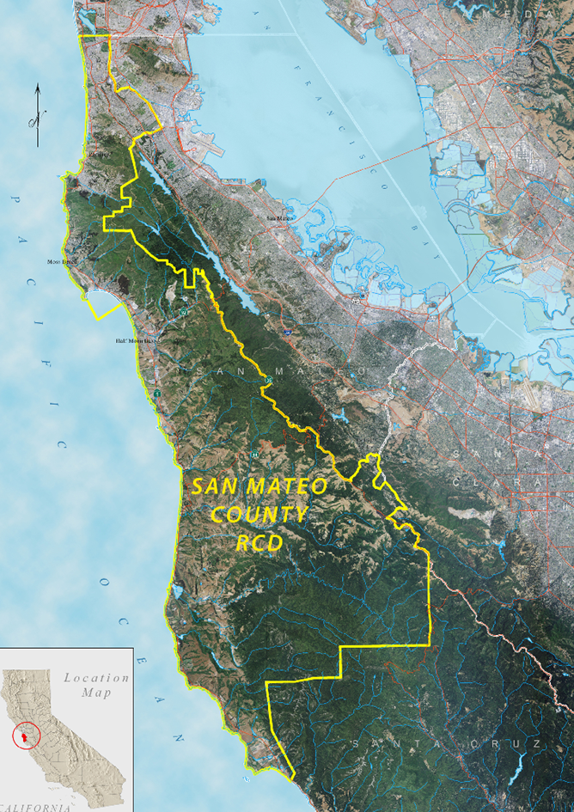
Since 1939

Slide 3
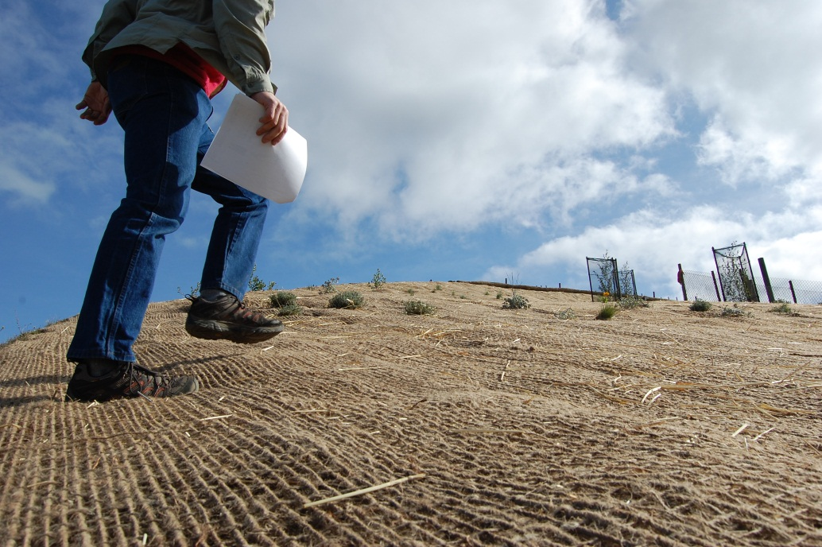
What We Do
Technical Assistance
Project Implementation
Conservation Planning
Education and Outreach
Partnerships

Slide 4
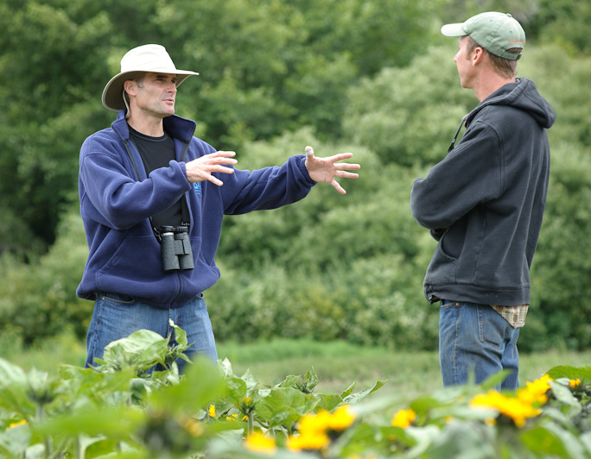
Our Work Is
Non-regulatory
Discreet
Free

Slide 5
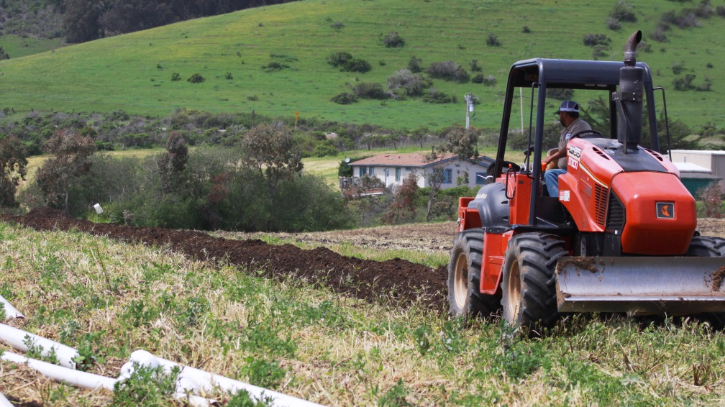
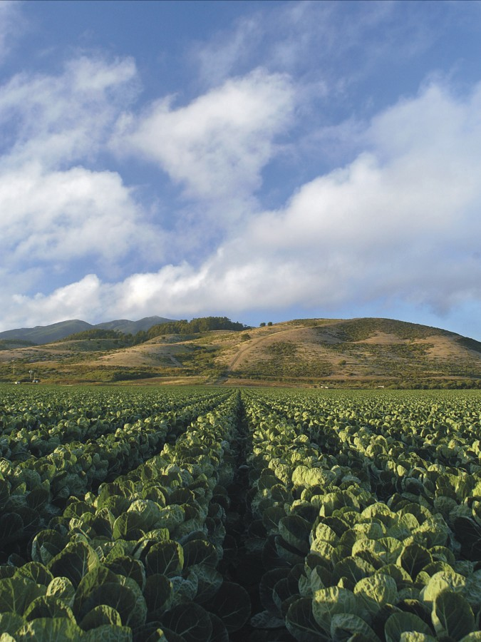
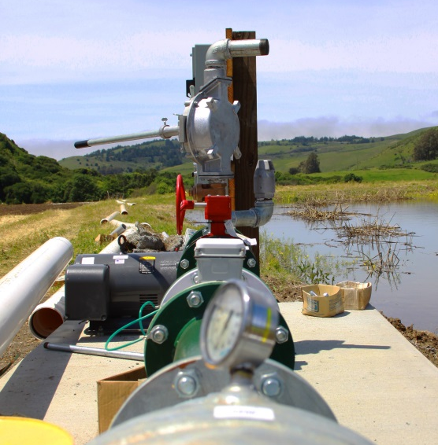
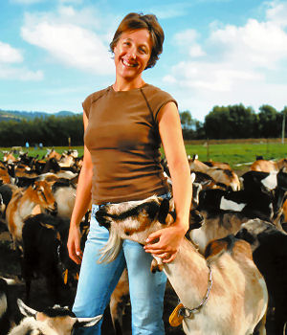
Agriculture

Slide 6
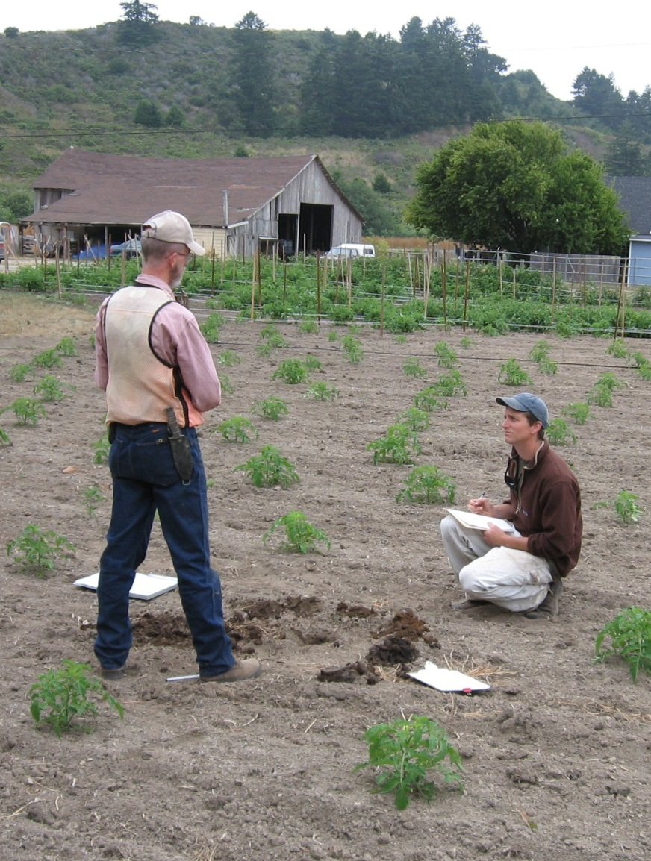
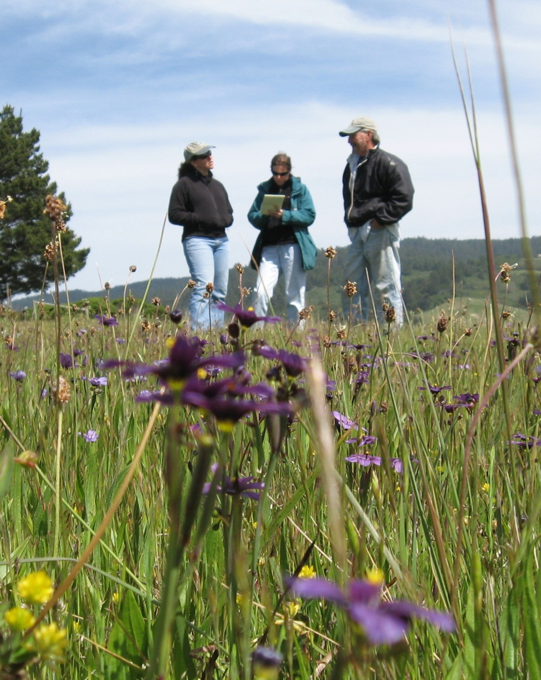
Technical Assistance & Conservation Planning

Slide 7
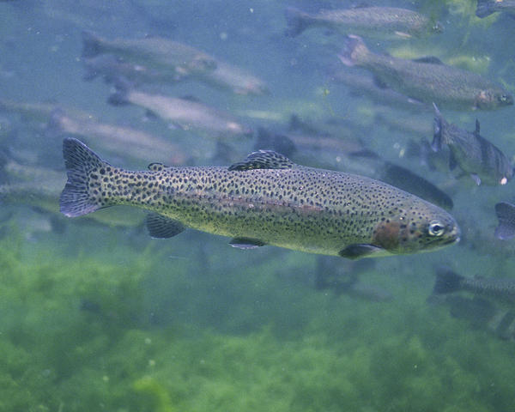
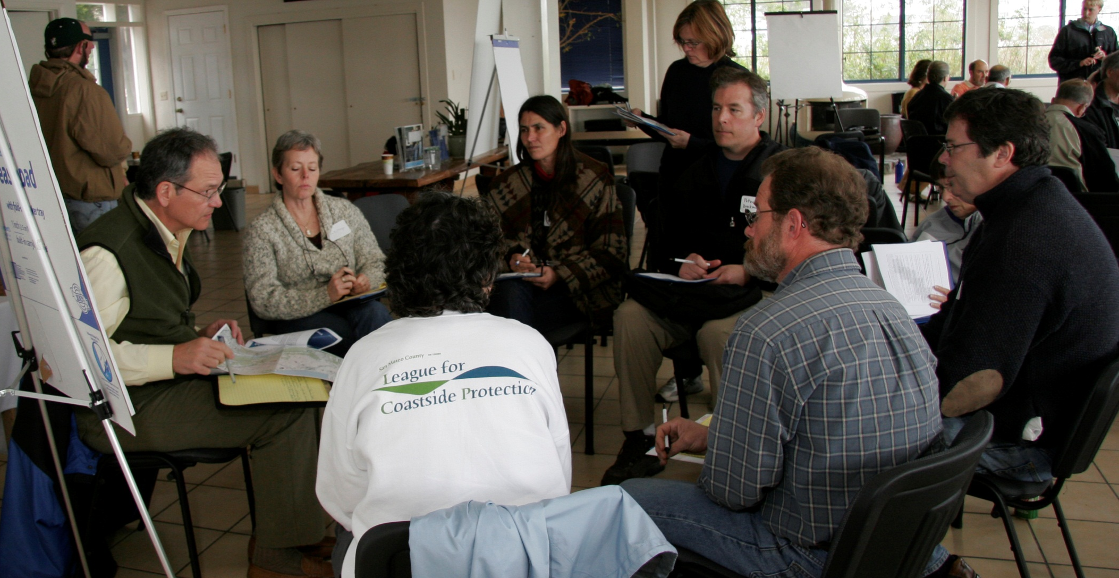
Limited Water Resources

Slide 8
Ponds Program

Slide 10
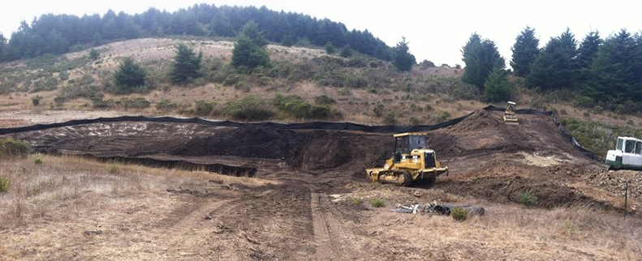

Slide 11
Other Water Storage

Slide 13
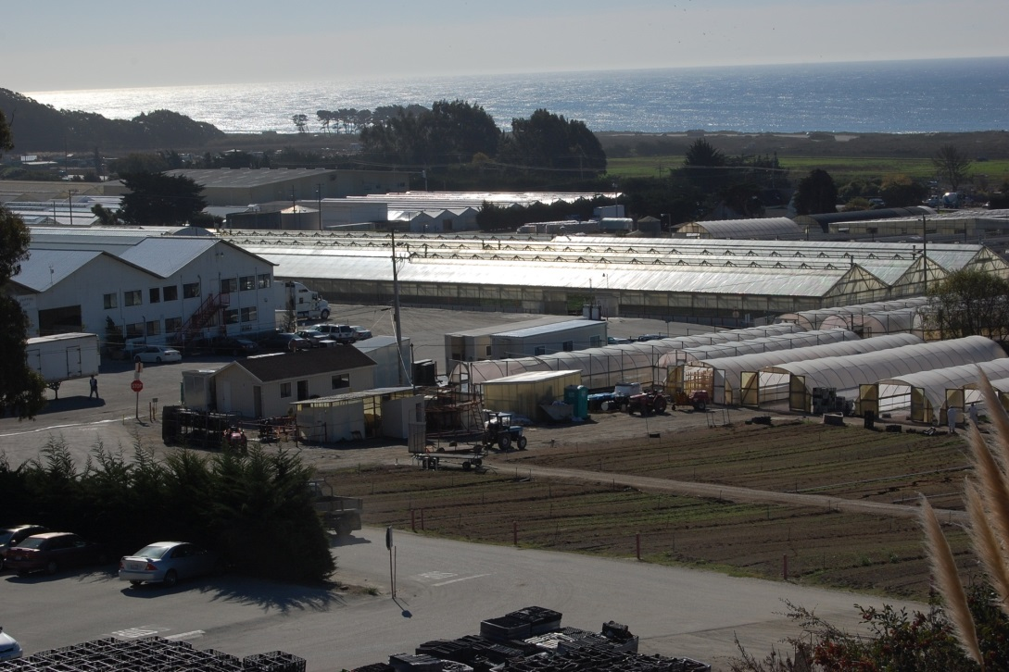
Water Conservation

Slide 14
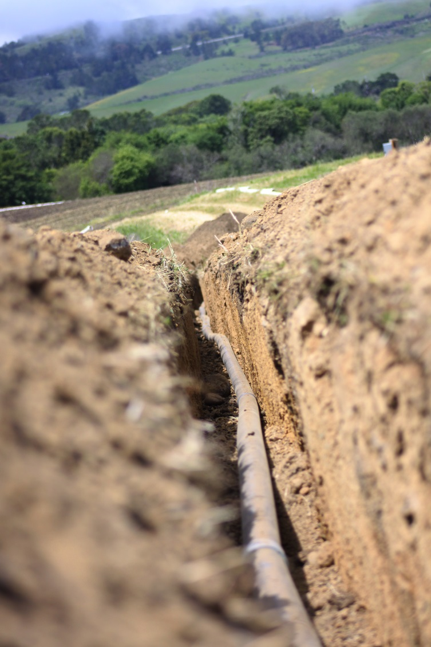

Slide 16
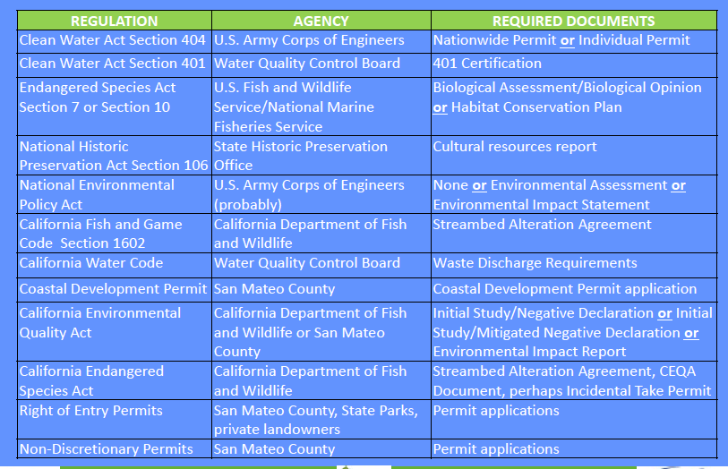

Slide 17
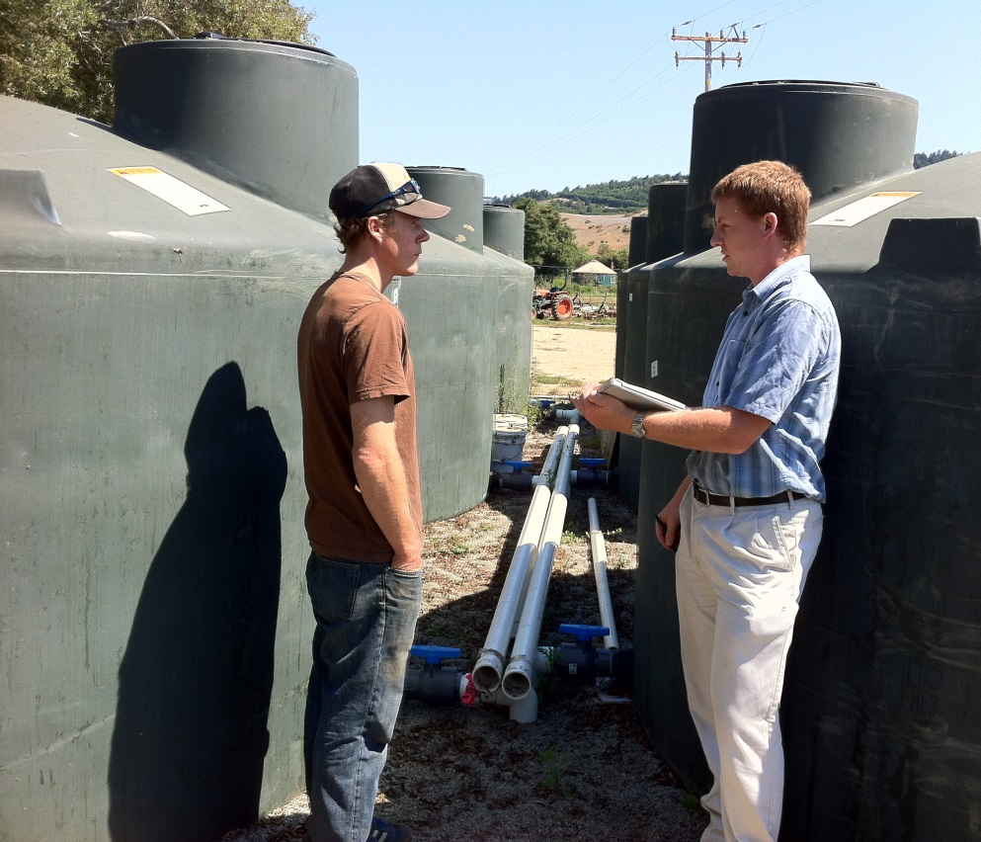
How Can We Help You?
Pond development and repair
Irrigation improvements
Rainwater harvesting
Improving soil health
(for irrigation efficiency, drought tolerance, water retention or drainage, etc.)
Water development
Assistance with permits
Funding and cost-share

Slide 18
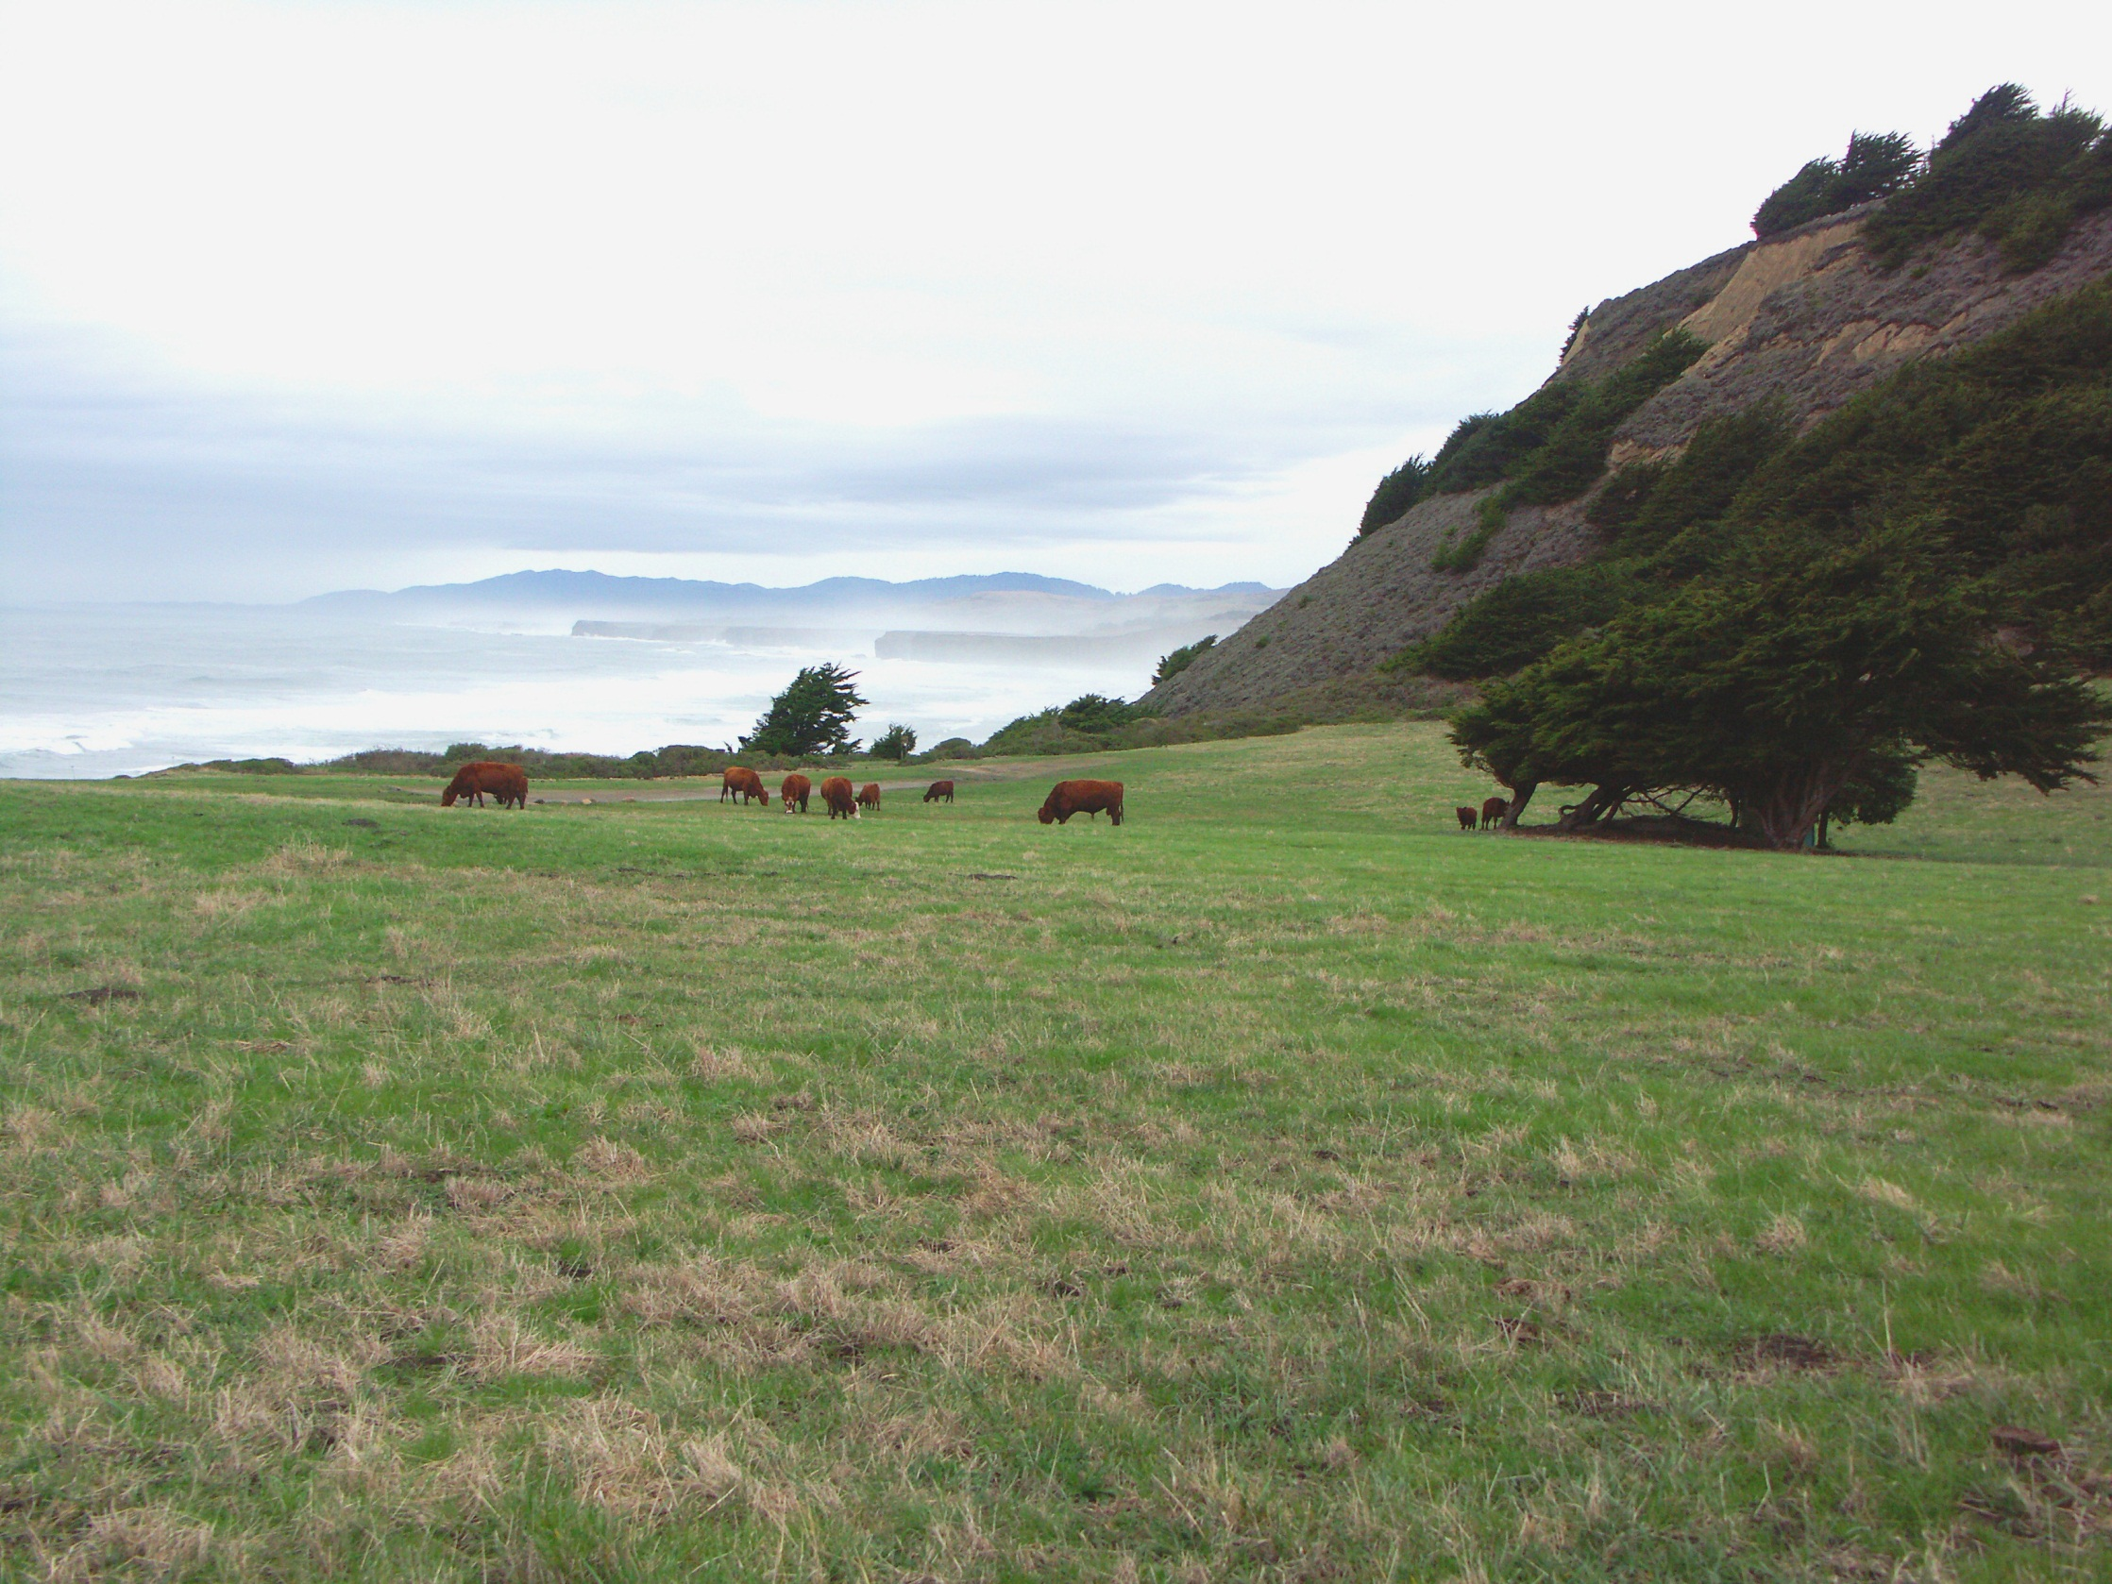
Thank you
Kellyx Nelson
Executive Director
San Mateo County Resource Conservation District
kellyx@sanmateorcd.org
650.712.7765

